Slide 1
Valuation, Rent, Cap Rates & Expense
Moderator: Michael Torreyson, FHA Deputy Chief Underwriter, FHA Group | Lument
Panelist: Patrick Dieter, Senior Underwriter | HUD
Panelist: Bob Lefenfeld, Founding Principal | Real Property Research Group, Inc. (RPRG)
Panelist: Patricia Moroz, EMAD Regional Director, Regions I, II and III | HUD

Slide 2
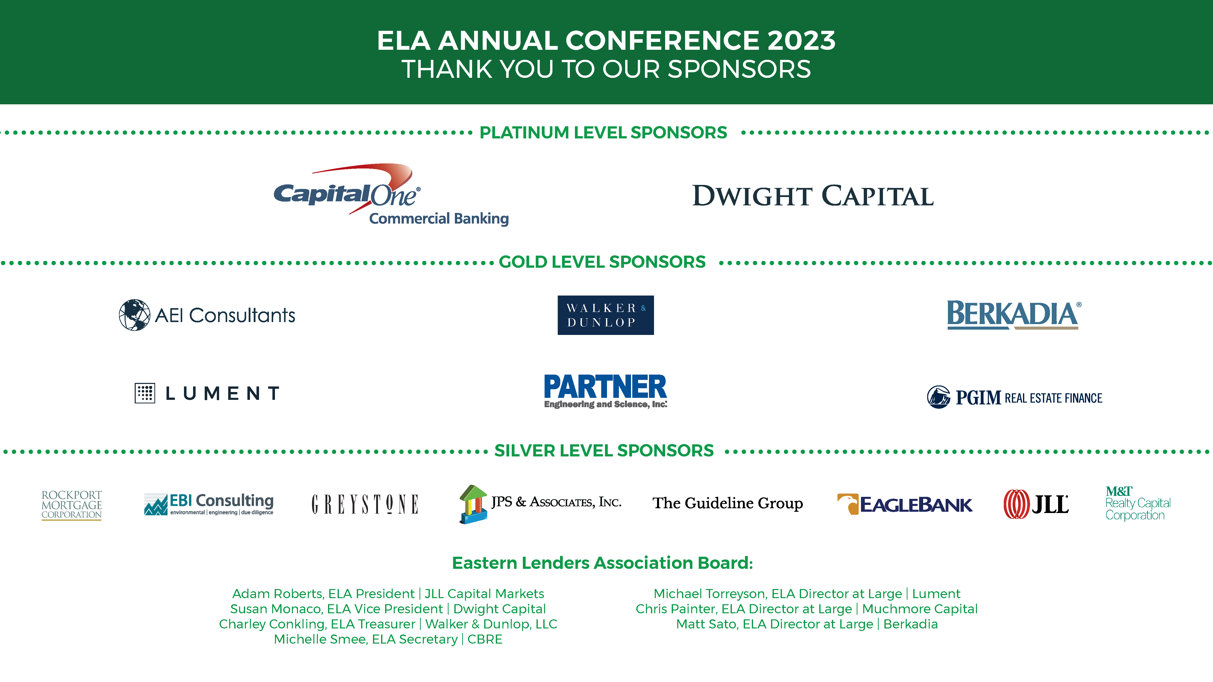

Slide 3
Valuations, Rents, Cap Rates, & Expenses

Slide 5

Stat Limit CNA Panel
Pending Cost Not Attributable Revisions

Slide 6
Background
Pre 2020 MAP Guide
Simple calculation (really only two paragraphs, 10 references)
Maximum CNA for each residential and commercial spaces could not exceed 15%
For 223(f) loans, 15% was pretty much always used for cost not attributable
For 223(f) loans, warranted price of land used was 100%

Slide 7

2020 MAP Guide

Slide 8

Background
2020 MAP Guide
More complex calculations (Multiple pages, 67 references)
Maximum CNA for each residential and commercial spaces combined could not exceed 30%
For 223(f) loans, mathematical gymnastics made CNA calculation somewhat challenging
Barry Wolfson’s response:

Slide 9
Background
2020 MAP Guide
April, 2021, Barry Wolfson pointed out some challenges with the calculations
May, 2021, David Wilderman reached out to a group of lenders and HUD staff in a quest to simplify the calculation
60-day PRA notice posted in Federal Register 9-12-2022
David Wilderman sent proposed ML to Barry Wolfson, who forwarded it to the working group and MBA for review and comment
RESULT?

Slide 10
Proposed Calculation
1 + 1 = 2

Slide 11
Proposed Calculation

Slide 12
Proposed Calculation – New Construction/Subrehab

Slide 13
Proposed Calculation – Refinance

Slide 14
Proposed Calculation

Slide 15
Proposed Calculation – New Construction/Subrehab

Slide 16
Proposed Calculation – Refinance

Slide 17
Questions?

Slide 18
Other PCNA Topics
Best Practices
Provide back-up documents to your 3rd party as early as possible.
  Drawings showing blocking, removable cabinetry
  Scope of Work
  VGB compliance info
  Accurate unit mix information
  Determine if accessible units noted on the rent roll are actually accessible
  Other 3rd party reports to complete early in process:
    Termite inspection in areas of heavy probability
    Sewer scoping for older properties

Slide 19
Other PCNA Topics
Accessibility
The PCNA will identify the applicability of accessibility standards​
  Americans with Disabilities Act (1990). ​
  Fair Housing Act (1988). HUD Fair Housing Accessibility Guidelines (1991). ​
  Section 504 of the Rehabilitation Act / UFAS (1973) ​

Slide 20
Americans with Disabilities Act (ADA)
Other PCNA Topics
ADA Standards for Accessible Design is enforced for all new construction and existing construction built after January 26, 1993. For older facilities ADA deficiencies must be corrected if readily achievable.
1991 ADA and 2010 ADA Standard applicability are typically determined based on date of permit application.
Multifamily Properties
The typical triggers are whether there are areas of public accommodation present.
    Leasing office
    Retail/Commercial spaces
    Areas accessible to the general public (e.g. Community Room, pool, etc.)
Typically does not apply to dwelling units.

Slide 21

Uniform Federal Accessibility Standards (UFAS)
The trigger is whether there is currently or previous Project Based Assistance (PBA) in place.
    If a property receives federal project-based assistance (e.g. Project Based Section 8, Section 202/811 loan, BMIR Loan, 236 Loan, HOME Funds, etc.), UFAS Section 504 applies, 5% of the total units are required to be accessible and 2% of the units must be sensory impaired units.
    If the property does not have accessible dwelling units, third-party will recommend adding accessible units to meet the 5% and 2% rule. Your third-party vendor will be assessing representative standard units against UFAS to derive a better conversion cost estimate.
Three conditions make converting units technically infeasible:
    To achieve compliance, load-bearing walls would have to be relocated
    To achieve compliance, walls with significant plumbing lines/HVAC ducts would have to be relocated.
    Significant barriers on the accessible pathway from the building exterior to the dwelling units exist that would be difficult, if not impossible to overcome.

Slide 22

Fair Housing Act (FHA)
Applicable for all new construction and existing structures that were first occupied after March 13, 1991, or; the last building permit or renewal thereof was issued on or before June 15, 1990.
Other criteria for FHA
    Buildings constructed for residential use;
    Each building has 4 or more units;
    Covered dwelling units (e.g. all ground floor units in walk-up property or all units in an elevator building);
    Multistory townhouses are generally NOT covered by the accessibility requirements of the FHA because the entire unit is not on the ground floor.

Slide 23
Recently Constructed Projects
5 new safe harbors went into effect in March of 2021:
  ICC/ANSI A117.1 (2009)
  IBC 2009
  IBC 2012
  IBC 2015
  IBC 2018
Key notes about safe harbors:
  Safe harbors must be used in their entirety. The benefit of safe harbor status may be lost if the architect chooses to select provisions from more than one safe harbor.
  Once a specific safe harbor standard has been selected, the building in question must comply with all provisions in that standard. PCNA provided should be notified prior to engagement.
  If designers and builders depart from provisions of a safe harbor document, they must demonstrate that the dwelling units nonetheless comply with the FHA’s requirements.
  The applicable accessibility standards need to be determined, including safe harbors, at the inception of design and NOT negotiated during the PCNA or AEC HUD review process.

Slide 24
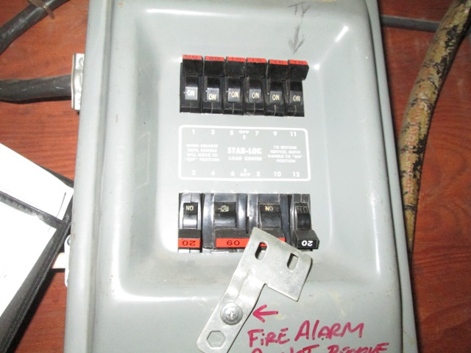
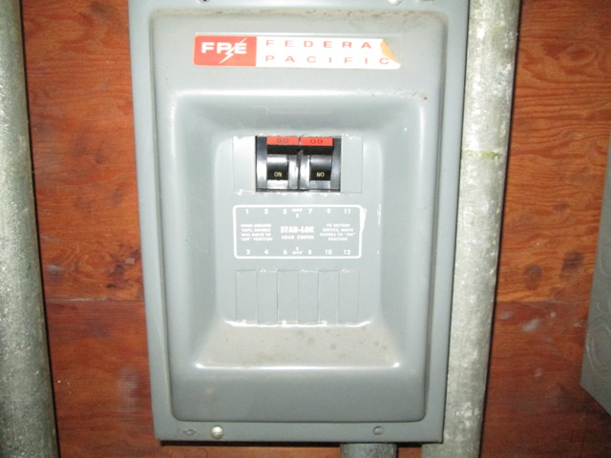
Other PCNA Topics
Issues to be Aware of?
  Federal Pacific (FPE) Stab Lok Electrical Panels:
    HUD requires Critical or Non-Critical 12-month replacement
      Can fail to trip in the event of over current, leading to potential fire events
      Be aware that having a licensed electrician letter may not be sufficient to push replacement to the Non-Critical Repairs or RR schedules.
        If property has history of fires, replacement would be a Critical Repair

Slide 25
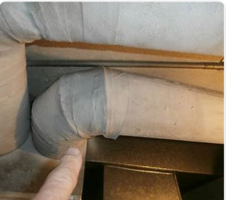
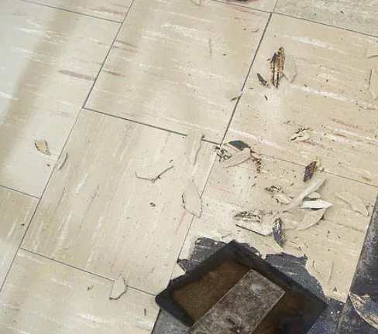
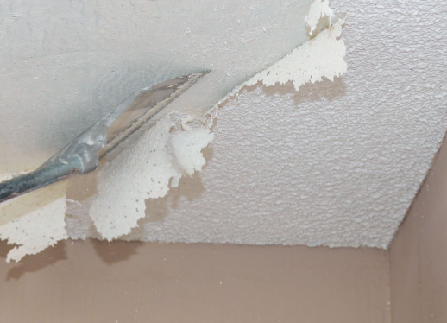
Other PCNA Topics
Issues to be Aware of?
ACM in Proposed Repairs
For projects that are undergoing some level of rehab (regular 223f or Heavy 223f) a pre-construction or pre-renovation survey is required and includes extensive sampling and higher costs. For post 1989 constructed properties, HUD requires reporting of any knowledge of asbestos use at the property and to verify the composition of roofing materials (receipts, labels, etc.) or sampling.

