Slide 1
NAVIGATING THE ROCKY ENVIRONMENTAL TERRAIN
Eastern Lenders Association
2023 Conference
March 13, 2023

Slide 2
NAVIGATING THE ROCKY ENVIRONMENTAL TERRAIN PANEL
Moderator: Susan Monaco – Managing Director/Chief FHA Underwriter - Dwight Capital LLC
Panelists:
Jacob Levine – Program Environmental Clearance Officer - HUD
Frederick Shaw – Technical Specialist Branch Chief, NE Region – HUD
Therese Fretwell – Regional Environmental Officer Region 2 – HUD
Keith Bayer – Managing Director of Environmental Services, Dominion Due Diligence Group

Slide 3
Our Topics Today:
Updates: Adoption of New ASTM Standards (2/14/2024), renewal of Authorization Memo (Section 106), Noise
Climate Change – examples, what does HUD want?
Pipelines
Wetlands
Fall Hazards
Questions?

Slide 4
UPDATES

Slide 5
New ASTM Standard
ASTM E1527-21 - Standard Practice for Environmental Site Assessments: Phase I ESA Process was released on December 21, 2021.
The MAP Guide requires the use of the most recent edition of industry standards to comply with environmental laws and regulations.
The EPA deemed the new standard compliant with All Appropriate Inquiry (AAI) rule effective February 13, 2023.

Slide 6
New ASTM Standard
EPA will still recognize Phase I ESAs conducted in compliance with ASTM E1527-13 as compliant with the AAI Rule until one year after the effective date of February 13, 2023.
HUD will in turn require the adoption of ASTM E1527-21 for all applications submitted effective February 14, 2024

Slide 7
New ASTM Standard Updates
Revisions to REC, HREC, and CREC definitions (though doesn’t adjust concepts) and all RECs, CRECs, and significant database must be included in the Conclusions section
More explicit requirements to review historical research
Revisions to site reconnaissance regarding specific items present AND not present
Requirements for site plan and site photographs to be provided
Specific notation of significant data gaps in the Findings section
Requires opinions on additional investigations (though recommendations still not required)
Emerging contaminants (e.g., per- and polyfluoroalkyl substances, or PFAS) included in non-scope considerations
See the AAI and ASTM E1527-21 Comparison posted by the EPA - https://www.regulations.gov/document/EPA-HQ-OLEM-2021-0946-0002

Slide 8
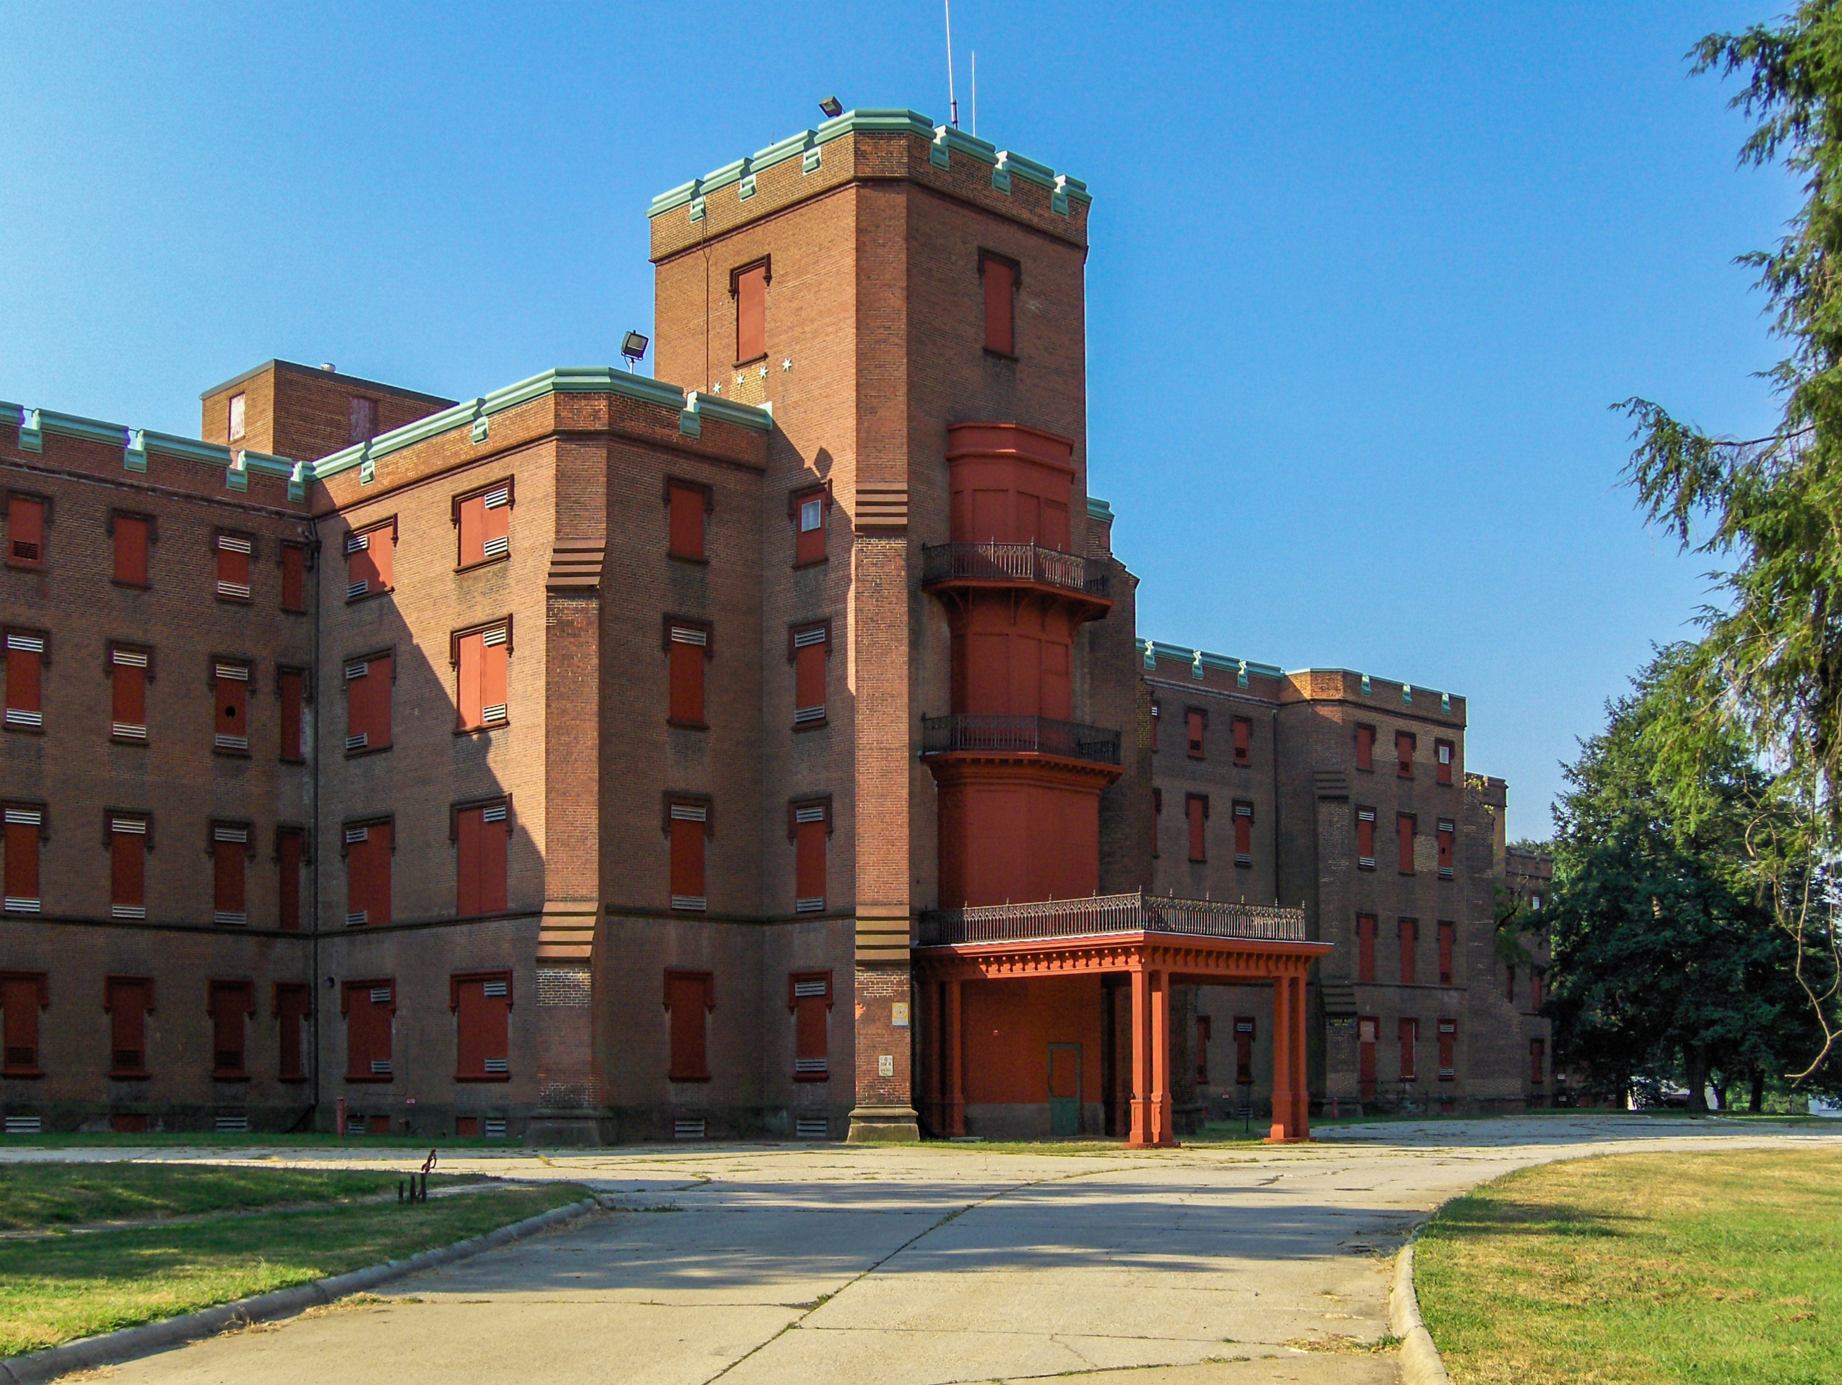
Section 106 Authorization Memo
Formerly Known As the Delegation Memo
Extended Until December 2027
No major changes, but clarifies key points about tribal consultation and HUD’s responsibilities
Make sure to attach the new memo to SHPO consultation letters

Slide 9
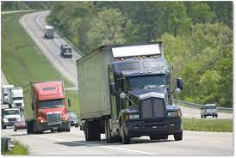
Noise Guidebook Update
Updated Noise Guidebook is still going through internal HUD review
LDAY is available for use on outdoor amenities that are closed at night, requires special approval
Housing is working on a new Fact Sheet that will cover LDAY and other key concepts from the Noise Guidebook

Slide 10
Climate Change

Slide 11
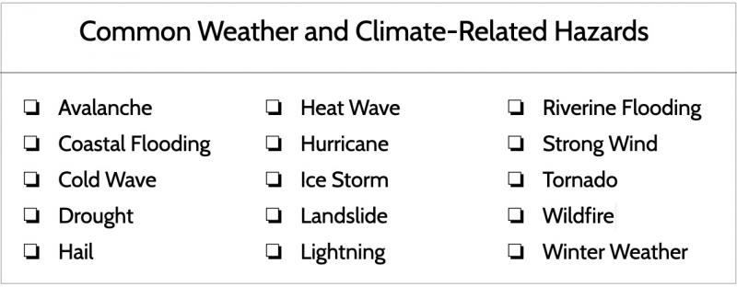
Climate Change
As outlined in the Administrative Memorandum “Guidance on Considering Climate Change in Environmental Assessment Factors for Multifamily Projects” signed by Willie Fobbs, after December 1, 2022, EA level applications must discuss reasonably foreseeable climate impacts over the life of the mortgage and address mitigation measures that would be prudent to implement at the construction stage.

Slide 12
Climate EA Factor Fact Sheet
Report preferred at Pre-App, but mitigation measures may require updates at Firm application
List recent additional data sources, including the White House climate mapping tool for resilience and adaptation (CMRA), and the U.S. Global Change Research Program
Addressing National Risk Index categories that are not climate influenced (volcanic activity, earthquakes)

Slide 13
Climate EA Factor Fact Sheet
How to analyze risks when robust data and projections aren’t available
Infer from broader regional trends and projections
Degree of confidence in risk level may affect mitigation decisions
Documenting analysis in HEROS
Risk analysis, mitigation discussion, and overall determination in the Impact Evaluation column
Only enter text in the Mitigation column if the project will include mitigation measures as a result of the climate risk analysis (don’t enter ‘N/A’ or ‘not required’)

Slide 14
Climate Change
Extreme temperature, cold wave, and severe winter weather considerations: (EA Factors)
Green Building certification being sought, if applicable
Building envelope design features (windows, doors, and insulation) that work to mitigate both cold weather concerns, also considering additional air and gap sealing efforts to limit exterior air infiltration.
Window treatments to provide additional cold weather shielding to resident living spaces
Specific local building code requirements that specifically work to address cold weather concerns (e.g., roof snow loads, building envelope requirements, utility infrastructure requirements, etc.)
Local early emergency notification systems, and any other planned notification and educational resources for future residents
Consideration for making the community center a resiliency hub in the event of a severe weather event.

Slide 15
Climate Change
Flooding considerations:
Review all effective, preliminary, and pending FEMA floodplain maps to determine site-specific conditions. HUD’s regulations in 24 CFR Part 55 and compliance with EO 11988 will drive the baseline measures.
For properties outside of the 100 and 500-year floodplain, additional considerations are less likely to be warranted, but are still possible.
For properties within the 500-year floodplain, additional flood proofing measures should be considered.
Sewer backup flooding can be a big issue!
Local early emergency notification systems, and any other planned notification and educational resources for future residents
Consideration for making the community center a resiliency hub in the event of a severe flooding event.

Slide 16
Climate Change
Tornado and hurricane considerations:
Specific local building code wind load requirements, with considerations for building envelope proposed construction features.
Local early emergency notification systems, and any other planned notification and educational resources for future residents
Consideration for making the community center a resiliency hub in the event of a severe weather event.
For hurricanes, additional flood proofing considerations may be warranted.
Coordinate with emergency management at the municipal or county level. Is an Evacuation plan needed?

Slide 17
Climate Change
Lightning considerations:
Specific local building code wind load requirements, with considerations for building envelope proposed construction features.
Local early tornado emergency notification systems, and any other planned notification and educational resources for future residents
Consideration for making the community center a resiliency hub in the event of a tornado event.
General considerations:
Review the applicable state and local hazard mitigation plans and consider similar design features being implementing into local infrastructure.

Slide 18
Climate Change
Additional Resources:
HUD Exchange EA Factors eGuide - https://www.hudexchange.info/programs/environmental-review/environmental-assessment/guide/climate-and-energy/
HUD Exchange Climate Change EA Factor Fact Sheet - https://www.hudexchange.info/programs/environmental-review/environmental-assessment/guide/climate-and-energy/
FEMA National Risk Index - https://hazards.fema.gov/nri/map
FEMA Hazard Mitigation Plan Status - https://fema.maps.arcgis.com/apps/webappviewer/index.html?id=ec2fb023df744cf480da89539338c386
FEMA Hazard Mitigation Planning - https://www.fema.gov/emergency-managers/risk-management/hazard-mitigation-planning

Slide 19
Pressurized Pipelines

Slide 20
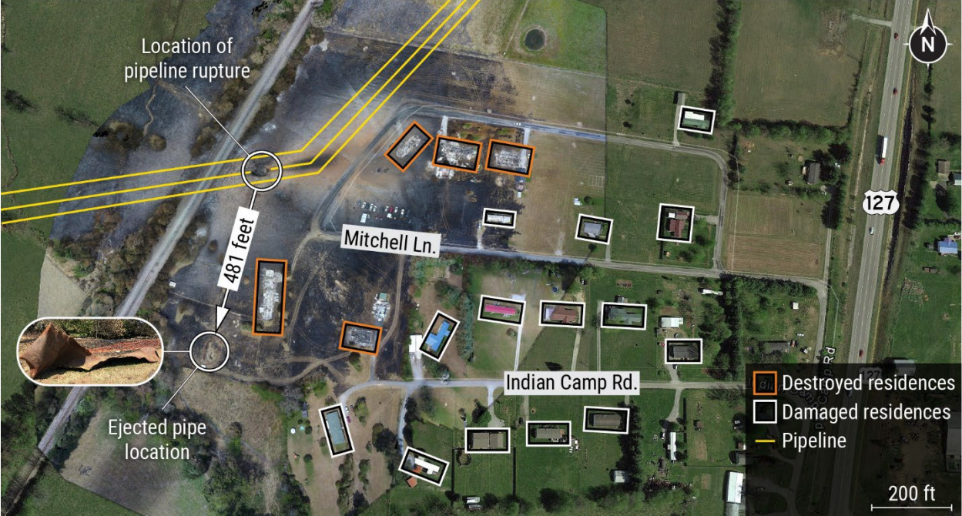
Pressurized Pipeline Incident Example
In August 2019, a 30” natural gas pipeline owned and operated by Enbridge, Inc. exploded, severely impacting a ¼ mile area and killing one person:

Slide 21
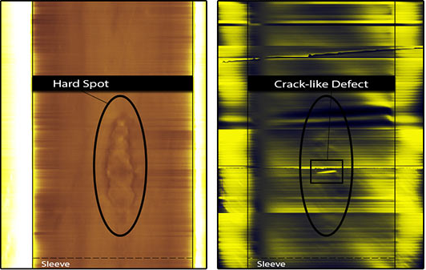
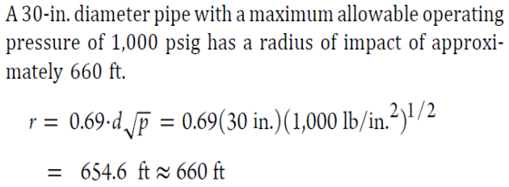
Pressurized Pipeline Incident Example
The National Transportation Safety Board (NTSB) conducted an investigation on the incident and determined the following:
Pre-existing hard spots (a manufacturing defect), degraded coating, and ineffective cathodic protection applied following a 2014 gas flow reversal project resulted in hydrogen-induced cracking at the outer surface of the pipeline and its subsequent failure.
NTSB determined that the use of the Pipeline Impact Radius (PIR) equation did not include the full area at risk.
Note that HUD uses a more
restrictive PIR equation

Slide 22
Pressurized Pipelines
*Reminders*
9.6.19.A: For ALL PROJECTS, the easement of a pressurized pipeline (pipelines exceeding 200 psi maximum operating pressure) must be at least 10 feet away from structures, ancillary facilities, common areas, parking areas or like related improvements. This does not apply to distribution lines supplying only the facility itself.
9.6.19.B: For NC projects and SR projects where residential density is increased, must also assess the Potential Impact Radius (PIR) of above-ground and below-ground pressurized pipelines within a mile of the property. This includes onsite or immediately adjacent pipelines.

Slide 23
Pressurized Pipelines
Please also note that HUD released a Fact Sheet to clarify and expand on the pressurized pipeline requirements outlined in the MAP Guide.
https://www.hudexchange.info/programs/environmental-review/housing/fact-sheets/#map-guide-on-acceptable-separation-distance-and-pipelines
The Fact Sheet includes eleven (11) points of clarity and additional guidance with the two (2) subcategories listed below.

Slide 24
Pressurized Pipelines – What Will HUD Accept?
For buildings and structures
Underground pipeline depth of 3+ feet
For outdoor ancillary facilities or common areas
Underground pipeline depth of 6+ feet
For both buildings and structures AND outdoor ancillary facilities or common areas
Can’t be within 10 feet of the easement of pressurized pipeline (9.6.19.A)
Soil overburden between the project and pipeline has a high bearing capacity
Pipeline segment has passed its most recent inspection report with no unresolved violations.

Slide 25
Pressurized Pipelines – What Will HUD Accept?
If the buildings/structures and outdoor ancillary facilities and common areas conditions do not apply:
The engineering report must discuss whether other existing barriers such as roads built to Federal Department of Transportation (DoT) standards, topography, walls or buildings provide mitigation or whether the project must add additional mitigation to protect residents from thermal radiation.

Slide 26
Pressurized Pipelines
HUD further defined the requirements of the engineering report within their Fact Sheet:
Must be conducted and stamped by a licensed P.E. and should include the following:
Distance from pipeline to project site
The pipeline’s most recent inspection report
Conditions of the specific pipeline segment such as corrosion, damage, defects, deferred maintenance and historical incidents such as leaks or releases
Pipeline depth or pipeline aboveground exposure
Type of soil in soil column from pipeline to project from Geotech survey or U.S. Department of Agriculture (USDA) soil survey map

Slide 27
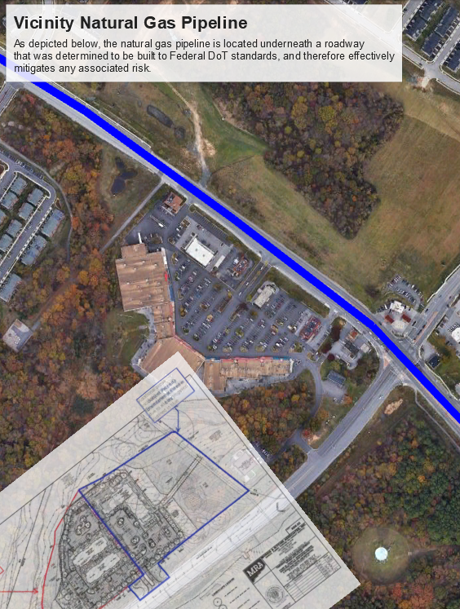
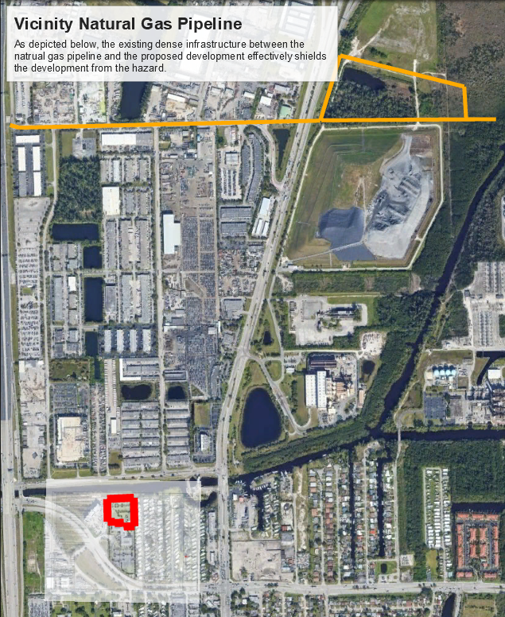
Pressurized Pipeline Example

Slide 28
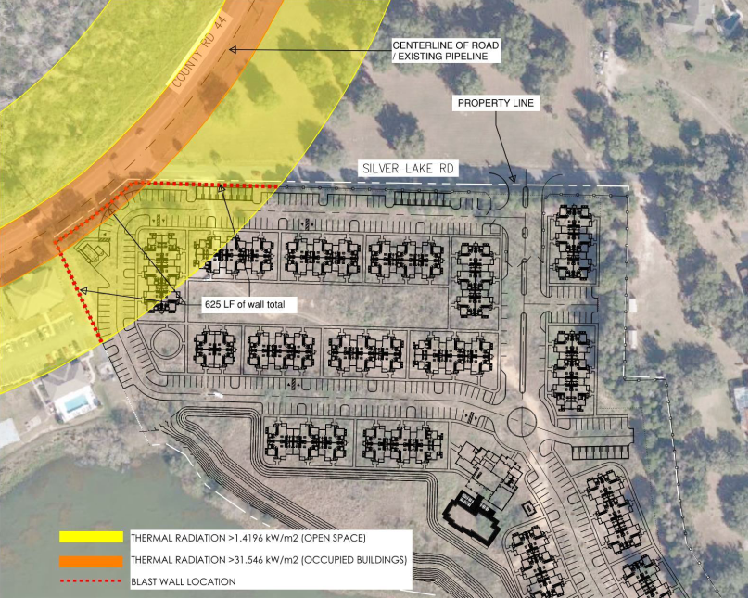
Pressurized Pipeline Mitigation Example
Mitigation example:
HUD MAP 221(d)(4) new construction
The licensed P.E. recommended that a 6’ tall, 8” thick, 4,000 psi concrete wall with continuous footing with 3,000 psi concrete be installed along the denoted 625 linear foot area of concern.

Slide 29
Pressurized Pipelines – The Good News!
HUD will accept PE recommendations as long as it meets HUD requirements and references HUD’s prescribed thermal heat flux threshold and blast overpressure threshold.
HUD has added a formula for estimating pressure to the pipeline fact sheet. This can be used as a last resort if the operator will not provide the pressure.​
Nelson’s position has been posted.

Slide 30
Wetlands

Slide 31
Wetlands
E.O. 11990 – Protection of Wetlands: Issued May 24, 1977 by President Carter.
Purpose is “to avoid to the extent possible the long and short term adverse impacts associated with the destruction or modification of wetlands and to avoid direct or indirect support of new construction in wetlands wherever there is a practicable alternative[.]”

Slide 32
Wetlands
​
E.O. 11990 vs. 404 Clean Water Act
Similar wetlands definitions but differ in application:​
E.O. 11990 Sec. 7(c): “Those areas that are inundated by surface or ground water with a frequency sufficient to support and under normal circumstances does or would support a prevalence of vegetative or aquatic life that requires saturated or seasonally saturated soil conditions for growth and reproduction. Wetlands generally include swamps, marshes, bogs, and similar areas such as sloughs, potholes, wet meadows, river overflows, mud flats, and natural ponds.“ EO is more explicit due to a greater number of examples.​
Section 404, 33 CFR 328.3(b): “The term wetlands means those areas that are inundated or saturated by surface or ground water at a frequency and duration sufficient to support, and that under normal circumstances do support, a prevalence of vegetation typically adapted for life in saturated soil conditions. Wetlands generally include swamps, marshes, bogs, and similar areas.”

Slide 33
Wetlands E.O. 11990 vs. 404 Clean Water Act (“CWA”) Differences
E.O. 11990:
Condition attached to federal spending; Spending power is broad in regards to conditions (see South Dakota v. Dole and NFIP)
Only limited by E.O. language, agency interpretation, and federal statutes
Applies to any wetland even if isolated, not navigable, or without a “requisite nexus” to such waters
404 Permits:
Regulatory in nature
Limited by CWA language “navigable waters” and those waters with a “requisite nexus” to such waters a.k.a “Waters of the United States” in CWA-speak
Requisite nexus requires an evaluation of hydrologic, ecologic, and geographic factors
The commerce clause is also a limitation

Slide 34
Wetlands E.O. 11990 vs. 404 CWA Differences (continued)
404 jurisdiction can be somewhat ambiguous but basically limited to:
Traditional navigable waters
Tributaries of the above that are relatively permanent (flow year round or continuous flow seasonally, typically three months)
Adjacent waters
Isolated water with “Commerce Clause” connection
Excludes prior converted cropland
Note: EO 11990 is only limited by its language/agency interpretation or specific statutory provisions

Slide 35
Wetlands
Sources for Wetlands Identification:
Army Corp of Engineers (ACE): https://www.nwp.usace.army.mil/Missions/Regulatory/Jurisdiction/#:~:text=Recognizing%20wetlands&text=Those%20areas%20that%20are%20inundated,life%20in%20saturated%20soil%20conditions.
Fish and Wildlife Services Classification Manual: https://www.fws.gov/wetlands/documents/classification-of-wetlands-and-deepwater-habitats-of-the-united-states.pdf

Slide 36
Wetlands
NWI Maps as initial screening tool
Delineation survey vs Overlay
USFWS contact (when) (1st contact) vs Wetlands Specialist
When is an 8-step needed? Direct or indirect impacts.
Incidental Exceptions
Restrictive covenants and closing procedures.

Slide 37
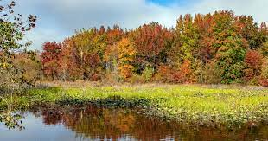
Restrictive Covenants and Other Assurances
For on-site wetlands not impacted by the project, HUD requires assurance that no future wetlands impacts will occur without HUD approval.
This often entails a restrictive covenant
Essential to reach early agreement on covenant language to avoid closing delays

Slide 38
Fall Hazards

Slide 39
Fall Hazards Fact Sheet
HUD released a Fall Hazards Fact Sheet - https://www.hudexchange.info/programs/environmental-review/housing/fact-sheets/#fall-hazards
Expanded definition of ‘ancillary facilities’ and ‘common areas’
Provides voltage ratings that define easement and fall hazard analysis requirements
Defines why buildings/ancillary facilities are prohibited within easements
Provides additional resources and links to online datasets

Slide 40
Fall Hazards – Ancillary Facilities and Common Areas
Ancillary facilities include onsite areas that are not residential buildings, but are there to support or complement residential buildings and are used by people:
Private balconies, front or back yards, divided green space or patios, carports, garages, sheds and pergolas or buildings like gyms, pool houses, etc.
Common areas are areas where people would likely congregate:
Playgrounds and outdoor recreation areas. Parking lots included within the site boundaries of, and designed to serve the residents of, a HUD-insured residential or mixed-use development are covered under this definition.

Slide 41
Fall Hazards – Voltage Ratings
69 kV or higher – transmission lines (high-voltage)
Requires compliance with both easement and fall hazard analysis requirements
Between 50 and 69 kV:
Requires compliance with fall hazard analysis requirements, but not easement requirements
50 kV or lower – local service lines:
Does not require compliance with either easement or fall hazard analysis requirements
*Note that HUD staff can evaluate whether any powerlines crossing a project site may pose a risk to residents or occupants.

Slide 42
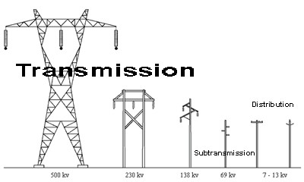
Fall Hazards – Voltage Ratings
Voltage Ratings

Slide 43
Fall Hazards – Easement Restrictions
No buildings, ancillary facilities, structures or common areas allowed within any easement of transmission lines carrying 69 kV or higher.
The easements of transmission lines create additional nuisances and hazards that merit the restriction on buildings and ancillary facilities altogether. These nuisances and hazards include:
Electromagnetic fields
Noise
Sparks from electric arcs
Access for utility maintenance activities

Slide 44
Fall Hazards – Additional Resources
Contact the utility provider directly
Maps of some powerlines are publicly available through the US Energy Information Administration and Department of Homeland Security

Slide 45
QUESTIONS? THANK YOU!

