Slide 1

Eastern Lender’s Association 2023 Conference
Mortgage Credit Panel

Slide 2

HUD
CHAPTER 8 UPDATE PANEL
Moderator:
Susan Monaco – Managing Director/Chief FHA Underwriter - Dwight Capital LLC
Panelists:
Peggy Lawrence - HQ Senior Production Specialist - HUD
Christina Garaffa - Senior Underwriter, NE Region - HUD

Slide 3
Our Topics Today
Why the Update?
Active vs Passive Principals
  Case Study
2530 requirements (Electronic vs paper)
New Matrix
Updated AAQs
Prior Approval – MC Exhibits required
Interest Rates
NE Region Best Practices
Questions?

Slide 4
MAP Guide Chapter 8 Update
What is the reasoning behind re-writing Chapter 8?
Regulatory Requirement for Agencies to review their published directives and forms every 3 years.
HQ initiative to Review and Update various Chapters of the MAP Guide every year
rather than updating the entire MAP Guide every 3 years.
HUD Chapter 8 Update – HUD and MBA Groups

Slide 5
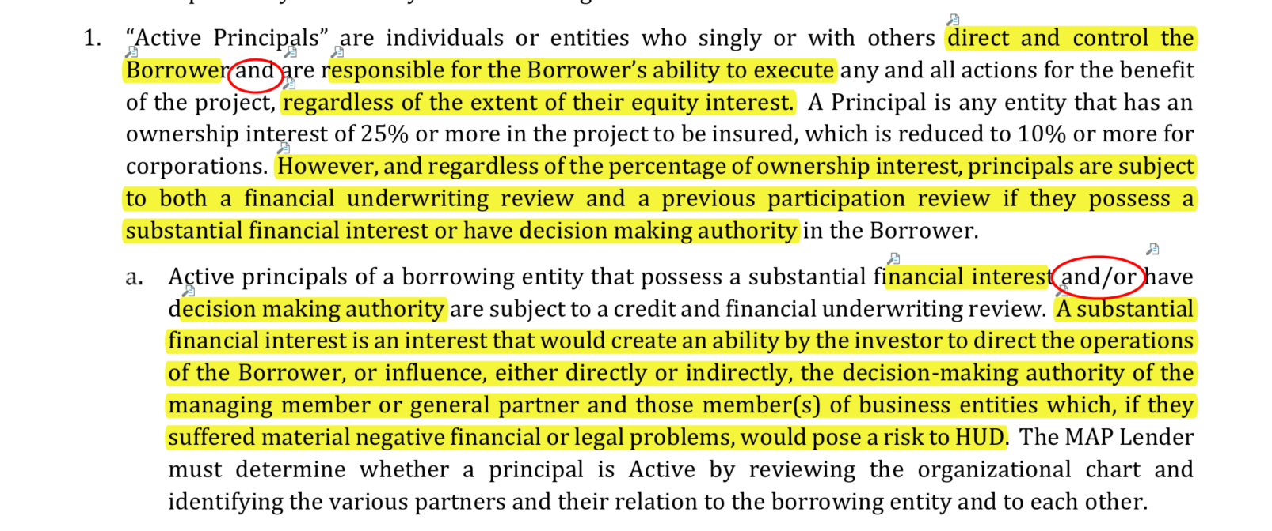
Case Study
Case Study
This 223(f) cash-out case study is intended to demonstrate:
When a Limited Partner should be treated as an Active Principal.
Difference in mortgage credit requirements among an Active Principal, a Section 50 Active Principal, and a Passive Principal.
Who should file for HUD 2530 previous participation review.
2020 MAP Guide 8.3.1: Determining Principals and Who is in Control
Section 8.3.1.B:
Notes:
It is important to remember that there are two questions to consider when asking ourselves if our principal is Active: Is this a decision-making role, and does the participant have substantial financial interest (despite their decision-making authority).

Slide 6
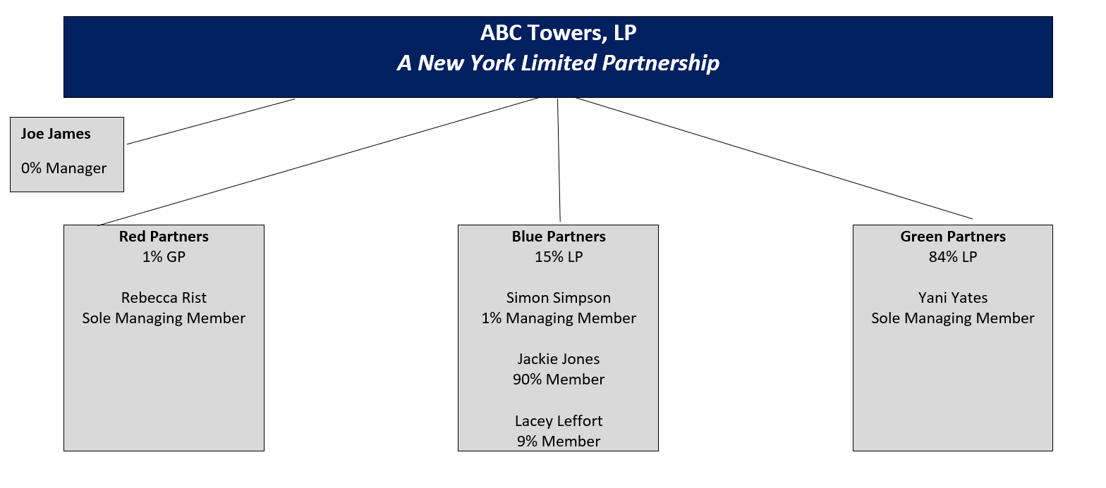
Case Study

Slide 7
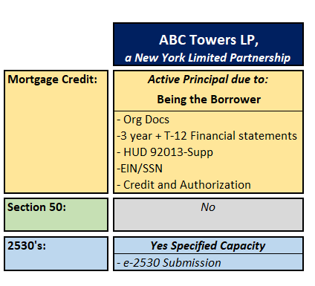
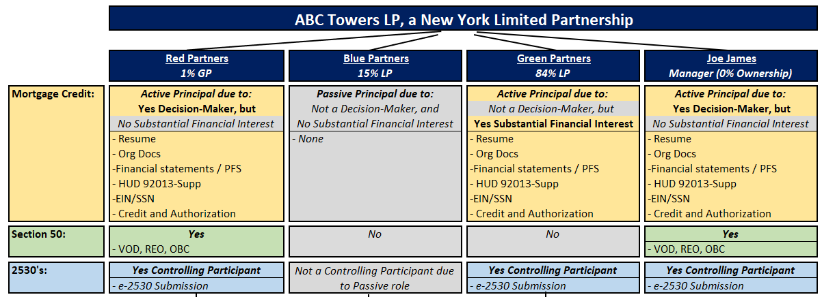
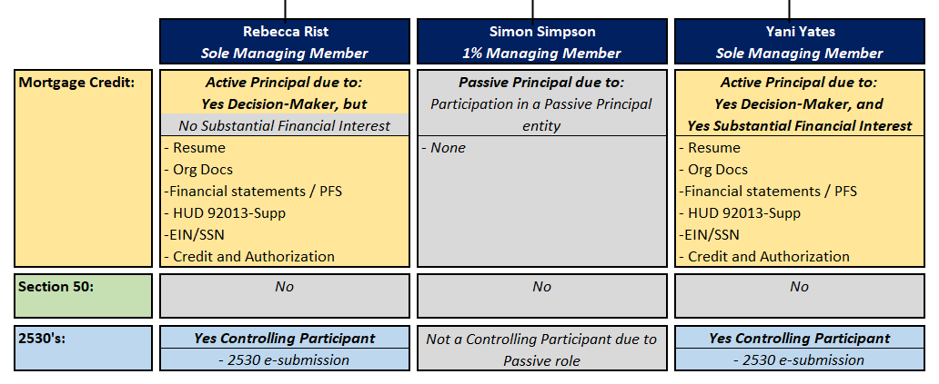
Case Study

Slide 8
2530s vs Mortgage Credit
  Previous Participation Review:
  Mortgage Credit Review:
  Standard industry review of credit and capacity (resume, experience, organizational structure, credit, litigation, other business concerns, REO, financials, and cash-to-close).
  This review is required for FHA financing activities with mortgage insurance.
  Evaluate the level of HUD program compliance demonstrated by the Controlling Participants of Specified Capacities presently and looking back 10 years.
  This review is required for interactions with HUD that go beyond FHA financing (i.e. change of managing agent, TPA, etc.)

Slide 9
Previous Participation Review
  Electronic Submission directly in APPS:
  Supports HUD’s commitment to digital loan processing.
  Increases the Underwriter’s efficiency.
  If the submission need be returned, the resubmission effort should be minimal.
  Even if a Participant doesn’t have experience to report today, submitting electronically sets them up for expeditious submissions on future deals.
  Electronic submission is highly encouraged.
  HUD 2530 form “Paper” submission:
  Takes the HUD Underwriter “offline” while vetting the paper form and manually searching property histories and conducting individual flag searches.
  Paper HUD 2530 form submissions often include hand-written errors and are discouraged.

Slide 10
New Mortgage Credit “Matrix”
2020 MAP Guide Appendix 8, Section A.8.4 contains a mortgage credit and underwriting review documentation matrix.
Today, we are sharing a more “user-friendly” reformatted matrix.

Slide 11
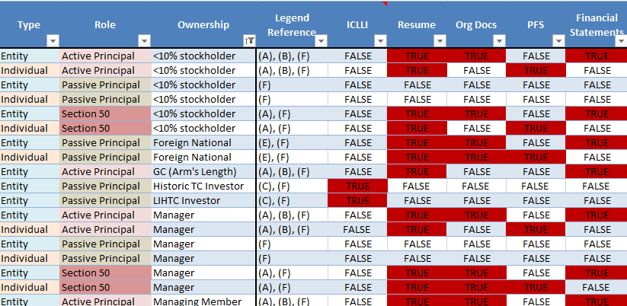
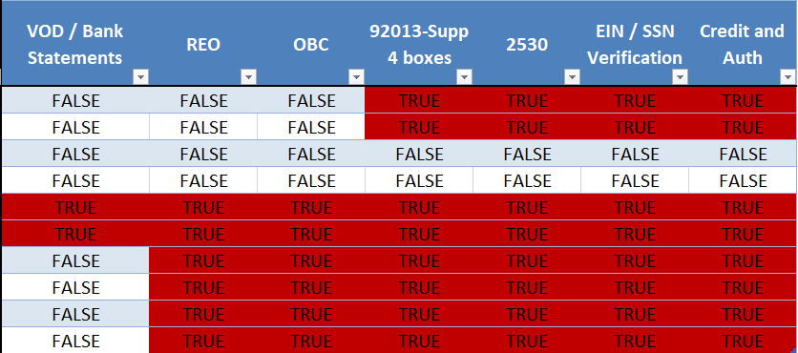
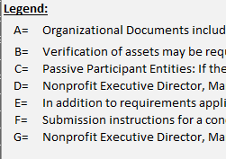
Case Study
Notes:
We have also added more scenarios into the matrix. With this new format, the user should have an easier time determining mortgage credit submission requirement once the Type, Role, and Ownership categories are determined. For now, this tool will be shared in PDF format. Shortly, we expect to release the tool in a secured excel format, which will allow the user to use the “sort” and “filter” functions of the table.

Slide 12
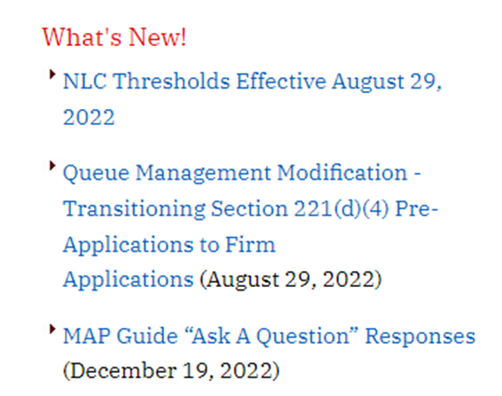
AAQ’s
AAQ (Ask a Question) system manages responses to MAP Questions or Clarify MAP Guide Instructions
The AAQ link is found on the main HUD MAP web page, and is on the “What’s New” sidebar: https://www.hud.gov/program_offices/housing/mfh/map/maphome

Slide 13
AAQ’s
Question:
It seems the MAP Guide is clear on which financial statements should be relied upon for underwriting purposes. Are lenders required to submit Trailing 12 month financial statements of project operations at the request of HUD underwriters? We are getting increased requests for borrower T-12/TTM statements even when the application submittal includes all the MAP-required financial statements (three years historical audits; YTD statements within 90 days).
Answer:
In order for the HUD Underwriter to compare the historical statements for debt service, Lenders are to provide operating income and expenses for the past 3 years of operating experience and the trailing 12 months of income and expenses. This will be updated in the next MAP Guide.

Slide 14
AAQ’s
Question:
Chapter 8.8.2.A.2 states if an IOI management agent exists, the lender should obtain financial statements. However, the matrix within A.8.4. says No. Which guidance should the lender follow?
Answer:
Financial statements are required for an Identity of Interest Management Agent for Section 8.8.2.A.2. of the MAP guide.
The reference that financial statements are not required (located in the Appendix 8,A.8.4 Mortgage Credit Document Matrix) is incorrect.

Slide 15
AAQ’s
Question:
The 2020 MAP Guide now calls for the submission of Form HUD-92013-Supp, Credit Authorization, and Credit Report for a NON-IOI Management Agent.
These items were not required under the 2016 MAP Guide for Management Agents that did NOT have an identity-of-interest; is it accurate that these items are now required, per new guidance?
Answer:
We apologize for the confusion. The Mortgage Credit Underwriting Documentation Matrix was posted with an error, by mistake. The error is a check that indicates a non-identity of interest Management Agent requires a HUD-92013-SUPP, credit authorization, credit report and a financial statement. This is incorrect.
A revision of the Matrix will check that a HUD-92013-SUPP, credit authorization, credit report and a financial statement are not required. Management Agent submission guidance supports this correction at Chapter 8 Section 8.8.2.A.2.

Slide 16
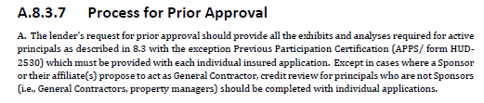
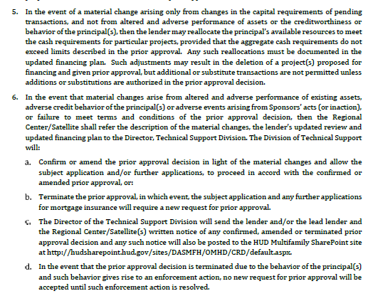

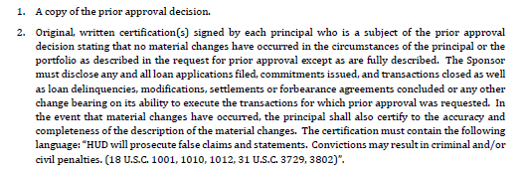
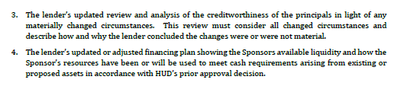

Prior Credit Approval
Mortgage Credit Exhibits for Project Applications after Prior Approval

Slide 17
Interest Rates
Per 2020 MAP Guide 3.1.4, HUD permits Lenders to close with one interest rate for the construction period and a different rate for the permanent loan period. Lenders must disclose this during underwriting. Special considerations for this scenario include:
a. Construction interest to be calculated based on the construction interest rate.
b. Permanent interest to be used in the DSCR analysis.
c. The Firm commitment and the HUD Note will differentiate between the two rates.

Slide 18
Best Practices from the Northeast
Organizational Charts:
  Break down each tier to natural persons (warm bodies)
  Identify the ownership percentage and title of each Participant (Manager, Managing Member, General Partner, Limited Partner, etc.)
  For mortgage credit purposes, identify both Section 50 Active Principals and the other (non-Section 50) Active Principals.
  For 2530 purposes, identify the Controlling Participants.
  The organizational chart submitted for the Borrower must represent the Borrower’s intended formation at closing. For IOI acquisitions, it is also helpful to have a titled org chart showing the structure of the present owner (Seller) and the Borrower (Purchaser).

Slide 19
Best Practices from the Northeast
2. T-12:
  Where Lender’s Narrative provides the historical spread (i.e. 3-years history + appraisal + underwritten conclusions) of the income, expenses, and NOI, include the T-12 data as well.

Slide 20
Best Practices from the Northeast
3. General Previous Participation points:
  2530s for a Specified Capacity must be submitted as a whole, and not be fragmented over different submissions or submission methods.
  Ask to see the flag printout list (if electronically submitted) or ask the Specified Capacity of open flags of which they’re aware. Have the Specified Capacity fix what it can before Application submission. Provide a write-up from the Specified Capacity describing why the flag occurred, what they have done to fix it, and what they have done to prevent the underlying condition from reoccurring.
  Ensure participant signature dates (HUD 2530 forms) or certification dates (electronic 2530 submissions) are as current as possible. These dates must be no older than 6 months by the time the HUD Underwriter processes the forms.
  The 2530 org chart must be identical to the org chart supplied with the mortgage credit application, but rather than containing “Section 50 principal” / “Active Principal” / “Passive Principal” labels per the mortgage credit review, it must contain “Specified Capacity” / “Controlling Participant” / Passive Participant” labels per the 2530 regulations.

Slide 21
Best Practices from the Northeast
3. General Previous Participation points (con’t):
  If submitted electronically through APPS, the mortgage credit section of the Application must include:
    The “2530 Submission Package” signature page, electronically-signed (or with digital signatures), AND
    A printout of each Participant’s previous participation list from APPS.
  When submitting electronically through APPS, select the correct reason for the submission. Borrowers, Managing Agents, and GCs must “mortgage insurance” when submitting for an FHA financing application; any other purpose may re-route the submission to a different HUD office.
  Paper 2530’s: Register in BPRS and Create a baseline to connect all tiers of the specified capacity.

Slide 22
Best Practices from the Northeast
Post-commitment amendment requests
HUD 92013-Supp
REO
7. Lender Risk Analysis that require specific Lender analysis

Slide 23
Best Practices from the Northeast
8. Bifurcated Mortgages (2-Tranche mortgages):
Within the application, Lenders should supply an excel-version of their mortgage calculation and their amortization worksheet showing the following:
  Base NOI piece mortgage and Savings Piece mortgage,
  The mortgage supported by each Tranche,
  Principal and Interest payments for each the Part A and the Part B notes, and
  A complete amortization schedule (Principal and Interest) for all Tranches together.

Slide 24
Q
MAP GUIDE CHAPTER 8 UPDATE
Questions ?

