Slide 1

Construction Administration
Contact: Sheila Galicki – Chief, Technical Specialist Branch
CAO: Feb 13, 2023

Slide 2

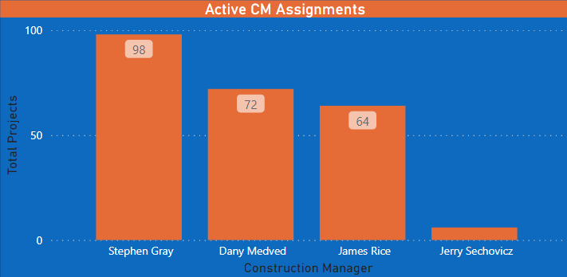
Insert Slide Title Here
Construction Management Assignments by Regional Office
BALTIMORE
BOSTON
NEW YORK
202 / 811
Note: 6x 202 or 811 Construction Projects in Progress (Counted Separately).
Data CAO: 2/13/2023

Slide 3
Insert Slide Title Here
Construction Management Team SOA Data
Section of Act | 202 (Non-Insured) | 220 NC | 221 (d)(4)SR/ NC | 223(f) | 231 NC | 231 SR | 241(a) | Total
Total # of Deals | 6 | 1 | 50 | 177 | 3 | 1 | 2 | 240
BAL % Per Program | 0% | 1% | 42% | 53% | 3% | 1% | 0 | 100%
BOS % Per Program | 0.0% | 0.0% | 5.5% | 94.5% | 0.0% | 0.0% | 0.0% | 100%
NYC % Per Program | 0.0% | 0.0% | 6.5% | 90.3% | 0.0% | 0.0% | 3.2% | 100%
Overall % | 2.5% | 0.4% | 20.8% | 73.8% | 1.3% | 0.4% | 0.8% | 100%
Data CAO: 2/13/2023

Slide 4
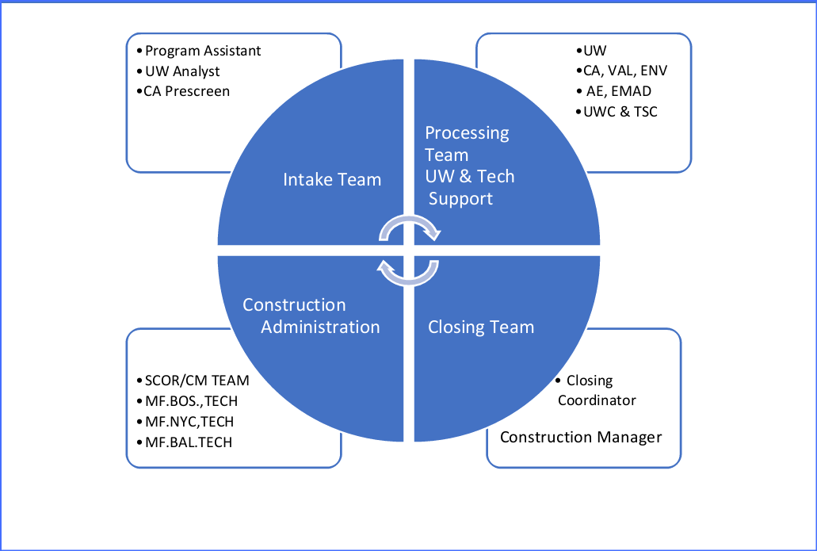
Insert Slide Title Here
Northeast Region Production Flow Chart

Slide 5
Insert Slide Title Here
Application Lifecycle
Intake Completeness Check
Application Submission Portal.
Catalyst Submission
Processing Complete - Commitment Issued to Lender
Closing Coordinator & Construction Management Team
Review Closing Package – Project Cleared to close.
Submit the Complete closing package, including special conditions; if plans are too large, if possible, submit via Catalyst.
Neclosing@hud.gov
Construction Managers
Performs All Construction Administrative Duties
All construction matters, NCR Escrow, CO, Equity Release. The project does not move to AM until all escrows and repairs are satisfied.
MF.NYC.TECH@hud.gov
MF.BOS.TECH@hud.gov
MF.BAL.TECH@hud.gov
Asset Management
Asset Management Incoming e-box
223f – All Repairs 100%.
D4 – Reach Final End.

Slide 6
Insert Slide Title Here
The Basics
A Heavy F is any transaction where the repairs exceed 15K per unit and/or Level II, Level III
Architect is Required
An Architect needs to sign a B104 Contract as the prescribed Contract.
The Architect must have the same insurance required for a Sub-Rehab.
General Contractor is required
A GC must sign an A104 as the prescribed Contract.
A GC must submit a 2530 Previous Participation Certificate to be processed by the UW.
Exhibits - All forms must tie together
CR & NCR are Extracted from the Etool only – no fees should be included - The Etool extraction is the HUD recognized exhibit.
Alternative Cost Worksheet - this form confirms the maximum per unit statutory limit and identifies the approved GC/AIA fees.
Relocation Plan
All Relocation Plans should be reviewed by the CA to ensure the plan matches the construction schedule.
All fees for the 3rd party relocation vendor must be on the 2264.
A Relocation Escrow must be executed (in MAP Guide).
Construction Impact on Environmental
If the property is undergoing construction, a pre-construction survey must be submitted and approved prior to closing.
All abatement expenses and fees should be detailed in the construction plan, Etool, and 2264.

Slide 7
Insert Slide Title Here
Construction Administration Items of Concern
New Construction/Sub Rehab
Reporting is incomplete.
Report does not meet Map Guide Requirements.
Contracts are overly redacted and noncompliant with the MAP Guide.
Closing /Construction Period
The project HUD is asked to close is not the project HUD committed to.
Changes to plans and specs after firm commitment.
Material cost change orders – see HUD QA.
Offsite storage.
Environmental requirements before final closing (supplying what the commitment requires).
Cost certification/2580 requests need to be completed, or is the math incorrect???
Substantial completion delays.
223f Heavy Refinance
Incomplete Due Diligence – kicking the can down the road.
Concept and coordination between the Architect and GC pricing, and CNA Etool provider disconnect.
Incomplete reporting
  Environmental considerations for construction.
  No professional GC.
  No-show Architect.
Closing /Construction Period
Change Orders for Cost? There is no contingency????
Substantial Changes to Cost and scope prior to closing.
Request sent to Asset Management vs Production Construction Administration.
Timely completion of repairs.
Servicing lender is not requesting Inspection via the HUD 3rd party.
Contracts and Agreements signed at closing not fluid!

Slide 8



Heavy 223(f)’s – Best Practices
March 15, 2023
Panelists:
Sheila Galicki, Branch Chief - Technical Specialist Branch, HUD
Jeb Bonnett, Director of HUD Building Assessments, AEI Consultants
Moderator:
Matt Sato,
VP/FHA Deputy Chief Underwriter, Berkadia Commercial Mortgage

Slide 9

Agenda
Heavy 223(f) Projects
Advantages/Disadvantages
Repair Levels/Scope of Work
Schedules and Contracts
Best Practices 3rd Party/Lender – Being proactive at the beginning

Slide 10








Advantages of the Heavy 223(f)
Much improved processing speed over a D4 (**However, largely dependent upon owner/GC provided documentation and proper upfront due diligence by all parties involved)
Works great with 4% LIHTC
Largely, no Davis-Bacon wages
Depending on SOW, possibly no need for an architect or GC – Further discussed below.
Lesser construction administration requirements
More Favorable Interest Rates

Slide 11







Disadvantages of the Heavy 223(f)
The Cost Limit glass-ceiling (a threshold in more ways than 1…)
The 12-month time frame for completion of repairs
Incomplete, morphing, or VE’ed scopes of work
Potentially longer review times given the additional layer of review from HUD CA
Determining the required level of design and GC documents
Coordination between architect plans and GC scope/costs
Tenant relocation concerns – Need for Relocation Consultant (Most Cases)

Slide 12

Repair Levels for Refinance
“Heavy F” deals can include all repair types
Routine Maintenance, Level 1, 2, and 3 Repairs
Determine the Cost Range for Repairs per Unit
  $15,000 > Heavy F > $45,854** project would become 221D4 (excludes Anchorage, AK; Guam; Honolulu, HI; US Virgin Islands which is $68,781)
Architect/GC is typically required if:
  Level 2 or 3 Reconfiguration of space
  Greater than 3 trade contractors have significant involvement
  ** Currently based on ML 2022-05 per unit limit of $16,983 x HCP. Base Limit subject to change any day now

Slide 13
Repair Levels for Refinance - Continued
PROGRAM | CLASS OF WORK
 |  | CNA | DESIGN | CONSTRUCTION
223(a)(7) | Repairs & Level 1 Alterations not exceeding routine maintenance and <=$1,500 per unit | Required | n/a | List of Immediate Repairs/Costs, bids for trade or component items >$25k, dimensioned sketches of accessibility remedies, and work by qualified tradesmen
223(f) | Repairs & Level 1 Alterations <$15,000/unit | Required | n/a | Same as above
223(f) | Level 2 Alterations or any repairs and alterations =>$15,000/unit | Required | Project Architect | Itemized Repairs/Costs, Dimensioned drawings of reconfigured spaces, GC & HUD 2328** needed as determined by Project Architect ** HUD 2328 required for LIHTC Heavy F’s only
223(f) | Level 3 Alterations | Required | Project Architect | Itemized Repairs/Costs, Dimensioned drawings of reconfigured spaces, GC and HUD 2328** required for Level 3 Alterations ** HUD 2328 required for LIHTC Heavy F’s only
220,221, 231,241(a) | All classes of work | Required | Project Architect | Full drawings and specifications, Architect administration of work, GC & HUD 2328, Davis-Bacon wage standard

Slide 14

Architect formally required if:
5.3.3 Section 223(f) with Repairs and Alterations
5.3.3.1 When Project Architects are Required
A. The Borrower must hire a Project Architect to define work at the property when one of the following conditions is true of the property:
1. The Aggregate Cost (before General Contractor fees or allowances) of all the identified repairs and alterations equals or exceeds $15,000 per unit. a. This amount of $15,000 Aggregate Costs per unit used here as a threshold is different from the dollar per unit maximum cost that defines the boundary between Section 223(f) transactions and Section 221(d)(4) Substantial Rehabilitation. This threshold is not adjusted by the High- Cost Factor or the annual inflation adjustment. b. Costs exceeding this threshold are evidence that the proposed repairs and alterations are sufficiently complex that the services of a Project Architect are required to ensure the clarity and accuracy of design and specification documents necessary to guide and evaluate all construction. c. Remedies for accessibility deficiencies, if any, must be included in both the cost of repairs and alterations and the design documents.
HUD may waive the requirement to hire a Project Architect when the Aggregate Cost of all repairs and alterations exceeds $15,000 per unit but work is limited to repairs and Level 1 Alterations.
2. When the Aggregate Cost of repairs and alterations is less than $15,000 per unit but the proposed work includes Level 2 or Level 3 Alterations, a Project Architect must be retained to prepare drawings and specifications for the Level 2 or Level 3 Alterations provided as follows: a. Work proposed outside the work area where Level 2 or Level 3 Alterations will occur may be excluded from the Project Architect’s scope of work.; and b. When there are only Level 2 alterations proposed (no Level 3 Alterations), and the Level 2 alterations are nominal (e.g., enlarging a closet in a few units with no accessibility ramifications), the services of a Project Architect are not required.
Repair Levels for Refinance - Continued

Slide 15

Architect formally required – Closing requirements
19.6.1.9 Projects with Expanded Work
Owner/Architect Agreement. If a Project Architect is required by Chapter 5, Section 5.3, Lender’s Counsel must submit AIA Document B104-2017 Owner-Architect Agreement, with the additions/deletions report attached. The HUD Closing Attorney will review for completeness (dates, parties, signatures, description of work), and for material additions and deletions to the contract that should be reviewed by the RC Director. The AIA B104 form may not be altered in general, except for the deletion of binding arbitration and mediation provisions. Deletions that absolve one party from primary responsibility are not permitted. If there is an identity of interest between the owner and design Architect, there must be an unaffiliated Supervisory Architect with a separate AIA Document B104- 2017 agreement between the Borrower/Owner and the non-IOI Supervisory Architect. See Chapter 5, Section 5.2.
It is imperative that the Architect visits the site throughout the repair process in conjunction with the HUD Inspector. No-show architects are a no-go and have been problematic in historical deals. FYI – Lender is responsible for requesting and scheduling monthly inspections with the HUD Inspector.

Slide 16

GC formally required if:
5.3.3 Section 223(f) with Repairs and Alterations
5.3.3.2 When General Contractors are Required
A. The Borrower must hire a General Contractor to conduct all the work defined by the Project Architect and provide coordination as a single point of control for costs, scheduling, and conformance of the work to plans and specifications when one or more of the following conditions are true:
1. The Aggregate Cost** of repairs and alterations exceed $15,000 per unit, excluding General Contractor fees;
2. The proposed work includes Level 3 Alterations; or
3. More than three licensed trade contractors are to be employed for the work.
B. HUD may waive the requirement to hire a General Contractor when:
1. The Aggregate Cost** of all repairs and alterations exceeds $15,000 per unit but work is limited primarily to Repairs and Level 1 Alterations; or,
2. The owner has substantial experience and proven ability – this needs to be fully vetted by the Lender and 3rd party to avoid potential processing delays once submitted for HUD review.
5.3.3.3 Licensed Trades
A. When a General Contractor is not retained, the work items documented by the Architect (e.g., remedies for accessibility deficiencies, limited Level 2 Alterations) must be executed by qualified licensed trades (e.g., a plumber, electrician, framer, tile-setter licensed in the local jurisdiction). Similarly, repairs and Level 1 Alterations described as individual work items (or a group of closely related items) with an estimated cost of $35,000 or greater must be performed by qualified licensed trades contractor(s).
**Aggregate Cost Limit = [Base per Dwelling Unit Limit] X [High-Cost Percentage multiplier] X [Number of Dwelling Units]
Repair Levels for Refinance - Continued

Slide 17

GC formally required – Closing requirements
19.6.1.9 Projects with Expanded Work
1. Construction Contract. If a General Contractor is required by Chapter 5, Section 5.3.3, Lender’s Counsel must submit the AIA Document A104-2017 Owner-Contractor Agreement, with the additions and deletions report attached. The HUD Closing Attorney will review for completeness (dates, parties, signatures, description of work) and for material additions and deletions to the contract that should be reviewed by the RC Director for programmatic acceptability. Deletions that absolve one party from primary responsibility are not permitted.

Slide 18

Development of Scope of Work
(Critical & Non-Critical Repairs)
Initial assessment by CNA provider or AEC Reviewer, Architect, and GC
Scope must include ALL proposed improvements/repairs
Consideration to other funding sources (e.g. LIHTC, soft funds etc.)
Coordination of scope (owner, CNA, GC scope & construction costs)
What is needed for the AEC 3rd party review of a Heavy F project?

Slide 19

Development of Scope of Work - Continued
5.3.3.4 Scope of Work
All proposed work must be itemized as individual work items and descriptively listed as Critical and Non-Critical Repairs in the CNA e-Tool by the Needs Assessor preparing the CNA.
If and when engaged, the Architect must accurately describe the relevant repairs and alterations in drawings and specifications (plans and specs).
The Needs Assessor must ensure that all of the work described in the Architect’s plans and specs are accurately summarized and described as separate work items in the Critical and Non-Critical Repairs lists in the CNA e-Tool with appropriate details and characterization:8
  The Needs Assessor should identify and reference specific sheets, pages, schedules or specifications that address the repair work item identified in the CNA e-Tool. This referencing should be done by entering the relevant sheet/page numbers and/or schedules as the first words in the "Comments" box on the “Recommendations Screen” in the e-Tool.
  The comment should direct the Lender and the HUD Reviewer to the location or section of the Architect’s plans and specs where the listed work item is described, dimensioned, or otherwise detailed.
D. New LIHTC 223(f) transactions typically follow a development process significantly different from other HUD Section 223(f) refinancing/acquisition processes and HUD waives the required use of a Needs Assessor and the CNA e-Tool to describe Critical and Non-Critical Repairs. Instead, LIHTC 223(f) transactions should follow construction documentation procedures similar to substantial rehabilitation (see Section 5.6).

Slide 20

5.3.3.5 Construction Costs
Costs of the work items (estimates) must be provided in the CNA e-Tool, except for LIHTC transactions.
When a General Contractor is hired, the costs in the CNA e-Tool should reflect the price proposal (bid) and the bids uploaded as attachments.
The Lender must ensure that the Needs Assessor has reviewed the General Contractor’s cost estimate with the assessor’s own independent cost estimate.
When a Project Architect and/or the General Contractor are involved, form HUD-2328 is not to be used to report the costs by the General Contractor for 223(f) transactions. Instead of the HUD -2328, costs may be organized and reported in the CNA e-Tool as follows (Contradicts Appendix A.5.6.2.3.C.10)b. which references the HUD-2328. It should be noted this is an error in the Appendix and would only apply to 223(f) transactions with LIHTC) :
  The contractor's price proposal (bid) should be captured in the CNA lists of repairs and alterations. The contractor’s bid should be expressed as a certain dollar amount per appropriate unit of measure of the associated Alternative of the Component to be repaired or replaced.10
  Only the hard costs should be reflected in the CNA e-Tool Repairs lists. Soft costs, if any, should be separately itemized and reported. Soft costs include any architectural fees, General Contractors overhead, profit and general requirements, etc. See Appendix 5, Section A.5.12 for the 223(f) Repairs & Alterations Cost Worksheet11 that properly organizes and reports the summary of costs.
  The total cost of repairs and alterations that includes both the hard and soft costs should be reported on form HUD-92264-A, lines 7b and 10b.
  No fees payable to identity of interest contractors are mortgageable. Justified and itemized general requirements are mortgageable.

Slide 21

2328 replaced with the “223(f) Repairs and Alterations Cost Worksheet”
MAP Guide Appendix A.5.12
Summarizes all cost included (Hard Costs, GC Soft Costs, Design Fees, Other Fees)
Even though the HUD-2328 is not required; it has been suggested to have one provided to the 3rd Party Reviewer, if available, as it will assist in the accurate capture of all repair costs, the accurate completion of the Repairs and Alterations Cost Worksheet and assures the form HUD-92264 will have accounted for all the repair costs.

Slide 22
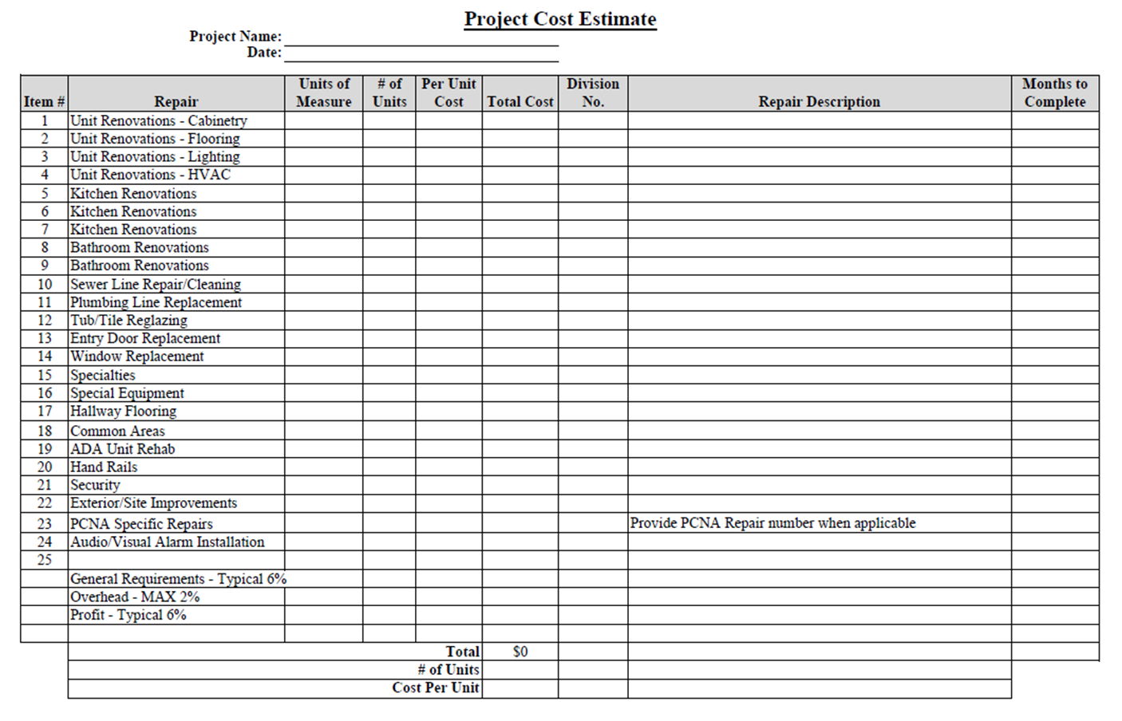
Convincing the GCs to give a great detailed format of their rehab scope/budget has been a tough sell throughout the industry. On the AEI side, asking for the HUD 2328 Form has been a way to get at least some information from a difficult GC in a format they are comfortable using. We are not suggesting using the 2328 to replace the repairs and alterations worksheet, but more as an internal helper during our AEC reviews.

Slide 23

A. When a General Contractor is retained, the General Contractor must submit a detailed construction schedule as described in Section 5.3.1.D above. The Needs Assessor must review the schedule and enter the number for “months to complete” for each work item in the CNA e-Tool. The number entered indicates the number of months from the initial closing until scheduled completion of the particular work item. The months elapsed is not necessarily the minimum duration of the construction for that particular item.
B. For all other transactions, the Needs Assessor and Lender, in working with the owner, must develop a construction timeline that reflects the planned completion of the work items and enter in the CNA e-Tool as “Months to Complete.” The timeline should ensure that all the proposed work (repairs and alterations) be completed as soon as possible and within 12 months of closing.
** The schedule should include the relocation timeline, when applicable.
5.3.3.6 Schedule **

Slide 24

Schedule Items - Continued
The Gannt chart is the industry standard and has the additional detail. The Gannt Chart must mirror the timeline as reflected in the HUD-5372 and align with Lender's draw schedule/Flow of Funds (FoF).
The Gannt chart has to incorporate/acknowledge relocation efforts and should always be sure to accurately reflect any deferred critical repairs.
Please document and be sure to identify the units that are involved during the repair process to assure proper inspection of the required repairs.

Slide 25

CONTRACTS
5.5.2 Section 223(f) Transactions
A. The use of contracts depends on the required professional services (see Section 5.3 above). Whenever an Architect and/or General Contractor is engaged, the contracts must be in writing using the forms acceptable to HUD as follows:
The Owner and General Contractor agreement shall be AIA A104, and;
Other AIA forms for change orders, requisitions of funds, and related processes referenced in these paired agreements should be used consistent with the terms of the agreements.
5.3 Requirements by Construction Activity and Program
A. HUD requires professional services, due diligence, and oversight suitable for the program and scope of work for each project. The Lender and Borrower must employ appropriate levels of professional services for the proposed work to ensure proper design and documentation, as well as successful completion of the work. The type of professional services and their responsibilities are determined by 1) the program (SOA) for which the application is submitted; 2) the Aggregate Cost of the work; and 3) the Classes of Work proposed (see MAP Guide Section 5.1). Both the Lender and the owner must engage qualified professionals for due diligence acceptable to HUD. See Section 5.2 for qualifications and responsibilities and Chapter 6, Section 6.4.8 and Section 6.6.3.A.7 for green MIP applications.
When in doubt, error on the side of over collecting!

Slide 26

Best Practices
Heavy F – Project Timeline
Step 1 – Lender/Borrower Project Kickoff
Define the Scope of Work
  Classify the Repairs
    Repair, Level 1, Level 2, and/or Level 3
  Determine the Cost Range for Repairs per Unit
    $15,000 > Heavy F > $45,854* (as of March 3, 2022, excludes Anchorage, AK; Guam; Honolulu, HI; US Virgin Islands which is $68,781)**
  Are you seeking a Project Architect Waiver?
  Has a General Contractor and Project Architect been chosen?
    Do they have HUD experience?
    Are there any IOIs?
    Are they comfortable with the HUD required contracts?
    Have they gone through a HUD AEC review before?
  ** See note on Slide #5

Slide 27
Best Practices
Heavy F – Project Timeline
Step 2 – Engaging Your 3rd Parties
Environmental Scopes
  Requirements vary based on the proposed scope of work. It is recommended that the proposed SOW is provided to the third parties when requesting proposals to help determine what scopes are needed. The Scope of Work is critical to the Environmental consultant as it provides necessary information to be able to correspond with the State Historic Preservation Officer (SHPO) per the HUD Delegation Memo as well as prepare the necessary hazardous materials reports based on the scope of work (asbestos, LBP and Radon). It is important to notify your Environmental consultant on any changes to the Scope of Work as it may result in changes to the SHPO submission, haz mat reports or level of Environmental Review. The Lender’s Underwriter is the nexus between the Environmental Testing Requirement and construction environmental hazards.
Appraisal
  When conducting a Heavy F, your AEC provided should be including the Cost Not Attributable as part of their scope. The appraisal is also needed to complete the Cost Not Attributable.
Capital Needs Assessment
  The CNA is to help inform the proposed scope. Any repair items cited will be needed to integrated to into scope
AEC Report
  The AEC process can take 6-8 weeks when accounting for the response period from initial draft review letters and final close out letters and receipt of all required documents

Slide 28
Best Practices
Heavy F – Project Timeline
Step 3 – AEC Review
AEC Kickoff Call (Borrower, Lender, Architect, General Contractor, and AEC Reviewer)
  Review the AEC document checklist
  Discuss any set timelines, is there a goal submission date?
  Discuss any IOIs
  Discuss the Architect/Owner/GC contracting relationships
  Set communication expectations
  Review the proposed scope of work
Typical Processing Procedure:
  Plan Review starts after receipt of at minimum 80% plans and specs and Narrative Scope of Work. Cost Review starts after receipt of at minimum 80% plans and specs, Narrative Scope of Work, Detailed budget.
    Average Turn Around of 10-15 business days for both .
  Project Architect and General Contract update documents and submit response letter.
    Average Turn Around of 10-15 business days for both.
  Response documents reviewed and if no further comments are required close out letters issued.
    Average Turn Around of 5-10 business days.
  As the reviews are on going, documents from the checklist are submitted to the AEC project manger to verify completion and compliance with the MAP guide.
  Once all the documents from the checklist have been received and review letters are closed out AEC report is issued.

Slide 29
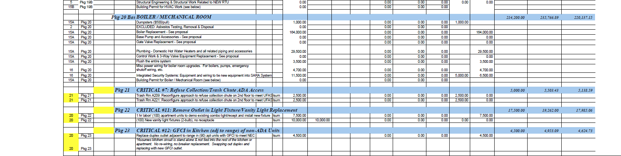
Best Practices
Heavy F – Project Timeline
Step 4 – GC Budget

Slide 30
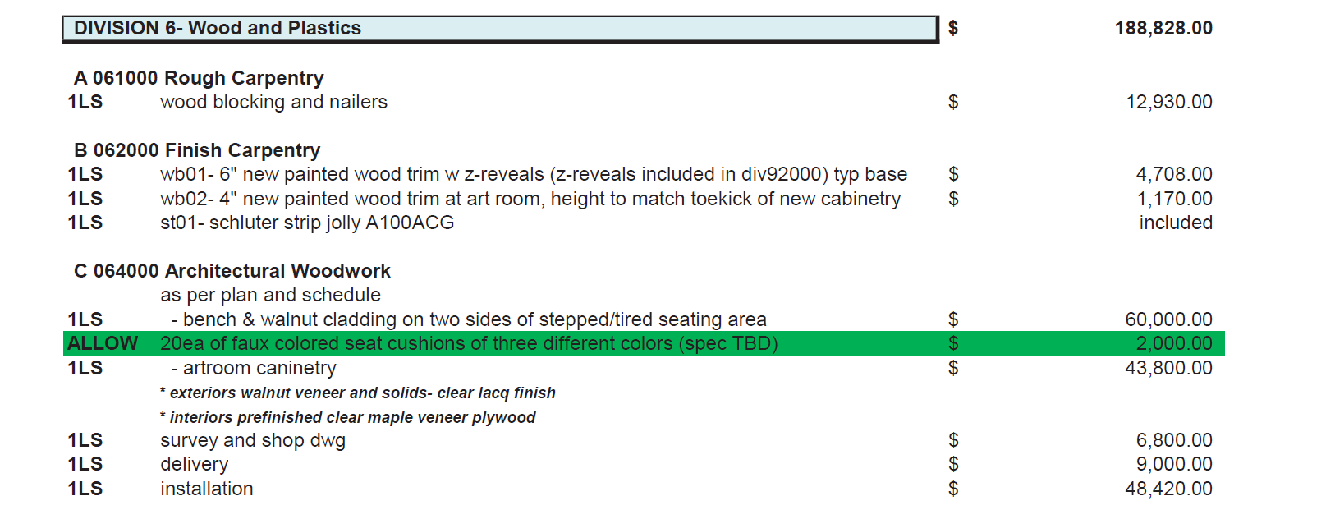
Best Practices
Heavy F – Project Timeline
Step 4 – GC Budget

Slide 31
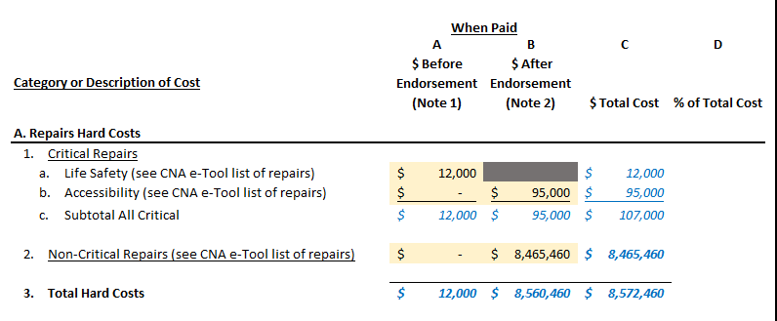
Best Practices
Heavy F – Project Timeline
Step 5 – Repair & Alterations Worksheet
Section A, items 1,2, and 3 are to match the e-tool.
Life Safety Items cannot be deferred.
Accessibility Items can be deferred.
The General Contractor will need to break out the exact cost for all Critical Repairs.

Slide 32
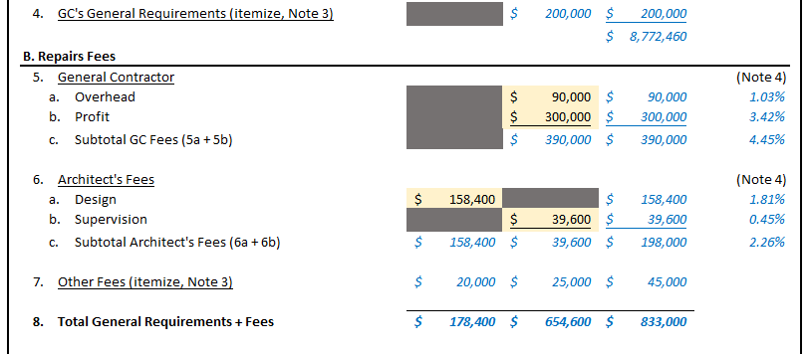
Best Practices
Heavy F – Project Timeline
Step 5 – Repair & Alterations Worksheet
Section A.4 and all of B are for reporting Soft Cost.
These will need to be provided by the Architect and General Contractor.
Use the itemized cost tab to populate A.4 GC’s General Requirements and 7 other fees.

Slide 33
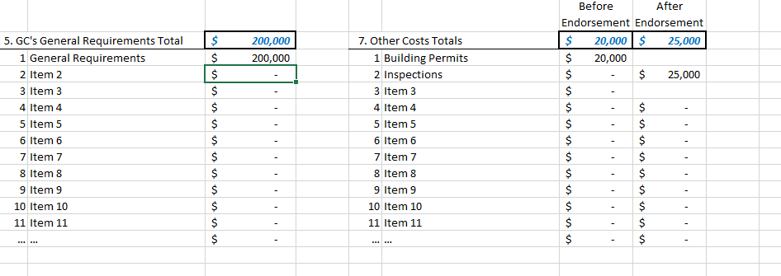
Best Practices
Heavy F – Project Timeline
Step 5 – Repair & Alterations Worksheet – Itemized Cost Tab

Slide 34

Lender’s Best Practices
Utilizing Lender Delegated Authority for most 223f projects (All Heavy F repairs and projects with complexity as determined by underwriting). Note: Critical repairs (e.g. accessibility and green) are not delegated to the Lender. HUD still approves these repairs. Also, Delegated Authority must be fully disclosed in the Underwriting submission and approved by HUD as special condition to the Commitment.
Assigning Lender led inspections at 35%, 65%, and 100%. Typically, AEI for example, will send their construction monitoring team to the property at the time of the pay application draw request.
Lender HUD Construction team monitoring 223f projects with heavy repairs similar depth like our 221d4 projects
Lender led site visits to educate the development teams on 223f procedures including repair draws, extensions, etc.
Consolidation of 3rd Party due diligence to single firm as obstacles can be encountered when multiple vendors involved on single project – Streamlined process
Communication with the entire production team to aid in expectations. Banker, UW, 3rd parties
HUD 2328 (if available) along with Itemized costs for critical repairs. This would be used internally for the Lender and 3rd Party to accurately capture the costs to reflect on the Repairs and Alterations Cost Worksheet.

Slide 35



QUESTIONS?
Moderator:
Matt Sato, VP/FHA Deputy Chief Underwriter, Berkadia Commercial Mortgage
Thank-you to our Panelists:
Jeb Bonnett, Director of HUD Building Assessments, AEI Consultants
Sheila Galicki, Branch Chief - Technical Specialist Branch, HUD

