Slide 1

Back to the Basics: 223(f) PCNA & ESA
ELA Emerging Professionals Group

Slide 2
ESA – Common Format
Table of contents
Executive summary & introduction
Subject property information
  Publicly available information
  Lender-provided information
Records review
Site inspection observations
Interviews & questionnaires
Additional considerations
Opinion & conclusion
Engineer’s signature & resume
Appendices
  Maps, photos, search results, additional supporting documentation
Notes:
Lori
Add in HEROS slide

Slide 3
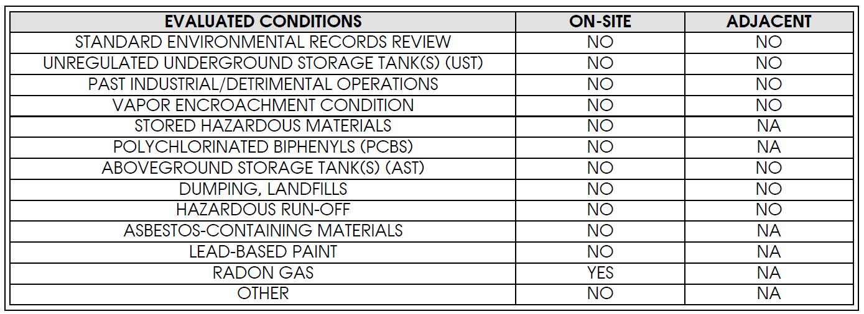
ESA – Recommendations & Conclusion
The report will outline if any RECs, CRECs, HRECs, or other de minimis conditions were identified, and whether there are any significant data gaps which would warrant a file review.
The report will often contain a summary chart outlining the evaluated conditions and whether they were identified on the subject site or sites adjacent to the subject.
Notes:
Lori

Slide 4
ESA – RECs, CRECs, HRECs, de minimis conditions
Defined in ASTM 1527-21
The presence of hazardous substances or petroleum products in, on, or at the subject property either due to a release or likely release to the environment or under conditions that pose a material threat of a future release to the environment.
Controlled REC (CREC): REC affecting the subject that has been addressed satisfactorily and allows the hazard to remain in place if proper controls are implemented (e.g. activity and use limitations)
Historical REC (HREC): not a current REC but was previously considered an REC and has been properly remediated, allowing the property to operate without any need to implement controls.
De minimis condition: not an REC. A condition related to a release that generally does not represent a threat to human health or the environment.
Notes:
Lori

Slide 5
HEROS – HUD Environmental Review Online System
HUD developed an online system for managing all environmental reviews.
It automates and streamlines the review process.
The Lender must provide information in HEROS regarding compliance with NEPA, the laws and authorities listed at 24 CFR 50.4, and the HUD-specific requirements, as applicable, as well as any issues that might affect the acceptability of the project, including any issues of compliance with state environmental laws.
Completed HEROS reviews are posted on the HUD website for public review.
Notes:
Katherine
The following must be addressed in HEROS:
1. Laws and Authorities
9.4. Contamination and Toxic Substances (and related Section 9.5 HUD Staff Responsibility in Cases Requiring Remediation of Contamination and Toxic Substances).
9.6.1 Lead-Based Paint
9.6.2 Asbestos
9.6.3 Radon
9.6.4 Historic Preservation
9.6.5 Floodplain Management
9.6.6 Flood Insurance
9.6.7 Wetlands Protection
9.6.8 Noise Abatement and Control
9.6.9 Explosive and Flammable Hazards
9.6.10 Air Quality
9.6.11 Airport Hazards
9.6.12 Coastal Barrier Resource
9.6.13 Coastal Zone Management
9.6.14 Endangered Species
9.6.15 Farmlands Protection
9.6.16 Sole Source Aquifers
9.6.17 Wild and Scenic Rivers
9.6.18 Environmental Justice
2. Housing and EA Requirements
9.6.1.19 Additional Hazards and Nuisances
9.6.1.20 Environmental Assessment Factors

Slide 6
ESA/HEROS – Supplementary Reports
Radon testing: required for all properties pursuing HUD financing
Fall zone study: required for properties with structures in fall hazard easements.
Vibration study: required for properties within 100 feet of a railroad track. The property should also be evaluated for any vibration-caused damage
Asbestos Containing Materials (ACM) Screening: required for properties constructed prior to 1989.
Lead-Based Paint (LBP) Screening: required for properties constructed prior to 1960.
O&M Plans: ACM, LBP, mold, radon
Modified 8-Step (5-Step): required for properties within the 500-year flood zone.
File Review: required when documentation related to potential RECs is not able to be obtained.
Phase II: required when an REC exists.
Notes:
Katherine
Make a 5 step slide
Mention MBA letter

Slide 7
HUD Floodplain Compliance –
8-Step & Modified 8-Step (5-Step) Process
Full 8-Step Process (24 CFR §55.20): For new construction or conversion in 100-/500-year floodplain.
1. Determine if the proposed action is in a 100- or 500-year floodplain
2. Notify the public (Early Notice)
3. Identify and evaluate alternatives
4. Identify potential impacts
5. Minimize and mitigate impacts
6. Re-evaluate alternatives
7. Publish final notice (Explanation of Decision)
8. Implement action with mitigation measures
Modified 8-Step (5-Step) Process: For existing properties in 100-/500-year floodplain. Does not require evaluating alternatives or public notices. Following documents required:
Elevation Certificate (FEMA Form FF-206-FY-22-152)
Evacuation Map showing flood exits
Tenant Notification System (text, email, broadcast, flyers)
Hotel Relocation Agreement
Lease Addendum & Emergency Contacts:
- Lease addendum for floodplain units
- Resident emergency contact sheet
- Historical flood info or no-flood statement
Notes:
Matt
The full 8-step process (under 24 CFR §55.20) is a detailed environmental review required for new construction or conversion in floodplains. It includes public notices, alternatives analysis, impact assessment, and mitigation planning to determine if the project should proceed in a flood-prone area.
The modified 8-step (often referred to as a 5-step process) is used for existing properties already located in the 100- or 500-year floodplain, typically in rehab or refinance cases. Instead of evaluating alternatives, it focuses on preparedness and risk mitigation, requiring specific documentation like an Elevation Certificate, evacuation map, tenant notifications, and emergency protocols.
In short:
Full 8-Step = Evaluate whether to build in a floodplain.
Modified 5-Step = Accept location but mitigate risk for existing properties.

Slide 8
ESA/HEROS – Potential Changes
MBA sent a letter to Secretary Turner on April 22nd outlining its recommendations for updates to the HUD MAP environmental requirements.
As stated in the letter, a number of environmental requirements have been added to the MAP Guide since 2011, many of which are not in any statute or regulation, add significant expense and time to multifamily projects, and limit new development.
Chapter 9 of the 2020 MAP Guide outlines HUD’s requirements to comply with the National Environmental Policy Act (NEPA). Executive Order 14154 eliminated the implementing regulations from NEPA, and the Council for Environmental Quality subsequently rescinded its NEPA implementing regulations at 40 C.F.R. Parts 1500–1508.
  This provides HUD and other agencies the flexibility to amend or eliminate many of their NEPA implementation rules.
Notes:
Sam

Slide 9
ESA/HEROS – Potential Changes (cont.)
Buried Underground Pipelines - The requirements for Buried Underground Pipelines should revert to the 2011 MAP Guide requirements of all structures must be at least 10 feet from the outer boundary of the easement.
Noise - HUD’s regulation should be revised to simply require construction projects to show that noise levels will not impact property marketability.
Fall Hazard - In order to reduce unnecessary cost to FHA-insured multifamily financing, the fall zone guidance should be revised to reflect the actual risk to the project. HUD should at a minimum revise the guidance back to the 2011 and 2016 MAP Guide coverage to just “structures” and ideally remove the requirement to evaluate fall zone hazards on typical free-standing structures.
High Voltage Transmission Line Easement - HUD should revise the guidance back to the 2011 and 2016 MAP Guide prohibition to just “structures.”
Vibration - Vibration should only be considered when it impacts on the marketability or structural stability of the property.
Radon - Consistent with Fannie Mae, HUD should defer Radon requirements to state and local jurisdictions.
Notes:
Sam

Slide 10
ESA/HEROS – Potential Changes (cont.)
Migratory Birds - HUD should remove the requirement for environmental reviews to be completed prior to site preparation.
200 Unit Limit Threshold for FECO Review - Eliminate the requirement for a FECO to review and comment on environmental assessment in multifamily applications based on number of units.
Site Aggregation - Limit environmental reviews for features like access roads, parking and utilities already on site.
Choice Limiting Actions - Borrowers should be allowed to begin all non-critical repairs and site preparation once the Firm Application is submitted to HUD.
Will-Serve Letters - Maintain the requirement to provide Will-Serve letters from utilities at firm application and do not allow environmental staff to require documentation that is not required.
Notes:
Sam

Slide 11
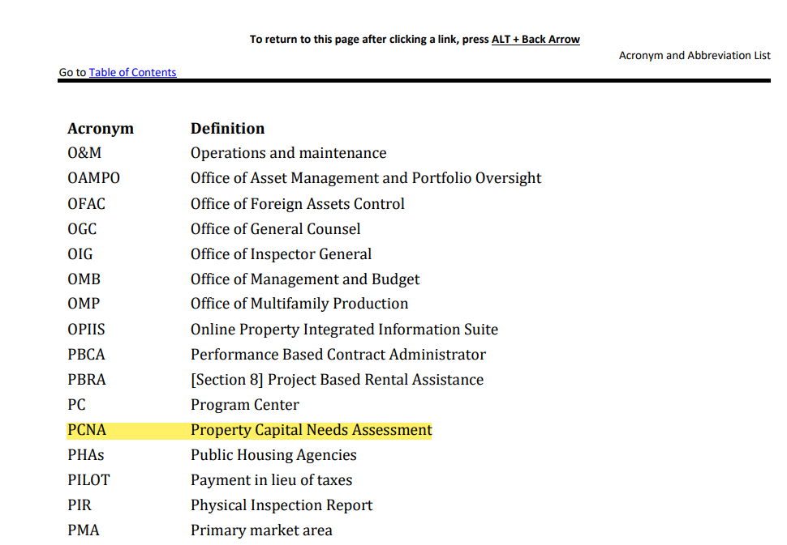
Property Capital Needs Assessment (PCNA)
Assessment of the Property's physical condition and historical operations.
Synonyms:
Capital Needs Assessment (CNA)
Property Condition Report (PCR)
Property Capital Needs Assessment (PCNA)
Property Condition Needs Assessment (PCNA)
Property Needs Assessment (PNA)
… basically, the same report with slightly different acronyms/names!
Bottomline: The PCNA assesses current property condition and future maintenance needs
HUD technically defines PCNA as Property Capital Needs Assessment on pg. 893/955 in the 2020 MAP Guide
Notes:
Helen

Slide 12
PCNA – Common Format
Table of contents
Executive summary
Purpose & scope
System description & observations
  Site, structural frame, building envelope, mechanical & electrical systems, elevators, stairways, life & fire safety, interior elements
Additional considerations
Document review & interviews
Other considerations
  Accessibility, additional examinations, owner-proposed improvements
Assessor qualifications, limiting conditions, certification
Appendices
  Repairs tables, replacement reserve schedule, photos, additional reports, maps, engineer resume
CNA e-Tool (HUD required online submission)
Notes:
Helen

Slide 13
CNA e-Tool Attachments (FHA)
Accessibility
Accessibility Survey
Corrective Action Plan
Green MIP Related
SEDI or SEP
Energy Data Plan
Green Certification Scoring
NGBS
GreenPoint
Miscellaneous
WDO/Termite Report
Flood Map
Wetland Map
Relocation Plan
Seismic Report
State Historic Preservation Office (SHPO)
Other Appendix Items from PCNA/AEC Report
General
Aerial Photos or Satellite Images
Photo Log
Site Plan
ALTA Survey
Certificate(s) of Occupancy (CoO)
RFR Financial Factors Tool
Municipal Letters (Zoning)
Tax Assessor Info
USGS Screen Shot, showing the SxS and Sx1 parameter values
Resumes/Statement of Qualifications and Experience of Needs Assessor
Bids for repairs over $35k
Construction Related
Noise Survey & STC Calculations
FF&E
Soil Report
If a Project Architect is engaged:
Owner/Architect agreement, AIA B108.
Drawings/sketches for reconfigured spaces and/or altered site improvements.
Full Plans/Specifications
If a Civil Engineer is engaged:
The owner/Architect agreement, AIA B108
Drawings/sketches for reconfigured spaces and/or altered site improvements.
If a General Contractor is engaged:
Construction Contract, HUD 92442M
Contractor’s and/or Mortgagor’s Cost Breakdown, HUD 2328.
Construction Progress Schedule, HUD 5372
Gantt Chart
Notes:
Helen

Slide 14
PCNA – Repairs
1. Critical repairs.
Life safety repairs must be completed before closing:
  Endanger health and safety of people
  Endanger physical security of the property
  Pose obstacles to ingress or egress from units, buildings or site.
  Prevent project from reaching stabilized occupancy.
  Any deficiencies/violations with building code, standards, and regulations.
Accessibility repairs must be completed before or within 12 months after closing with some exceptions (e.g. additional time to reconfigure a non-compliant kitchen).
2. Non-critical Repairs. Non-critical repairs address current and imminent physical needs, including deferred maintenance, and must be completed within 12 months after closing with some exceptions (e.g. additional time for Siding work).
"Imminent" means work reasonably expected to be needed within the first two years of the mortgage
Non-critical repairs may include work likely to restore, improve, or enhance the quality, suitability, marketability, and operating efficiency of the property.
Notes:
Helen

Slide 15
PCNA - Reserves
Replacement Reserve Definition: Custodial Account the Borrower funds during the Mortgage Loan term for Replacements. The replacement reserve balance is held by the lender/servicer.
Synonyms:
Replacement Reserves
RFR
R4R
… identifies specific project, building, and unit components to be replaced over a set period of time in the future
Replacement Reserve Schedule:
Borrower’s agreement to replace identified capital items and perform required maintenance;
terms for funding the identified capital item replacement and maintenance; and
disbursement of Replacement Reserve funds.
FHA Resource: 2020 MAP Guide, Appendix A.5.7: Capital Needs Assessments (pgs. 767-781/955)
Notes:
Connor

Slide 16
PCNA - Reserves
Reserve balance is based upon a 20-year estimate period, such that the minimum balance is 5% of the uninflated replacement reserve total, adjusted annually for inflation.
For HUD insured loans, any balance observed in years 11 – 20, that is less than the calculated minimum balance, cannot exceed 50% of the cumulative amortization of the mortgage.
Adjustments to financial factors in HUD's e-Tool are the responsibility of the lender and/or PHA for HUD Programs/Events that require the lender and/or PHA to act as the 'Initiator' of the e-Tool.
A new CNA is ordered by Servicing / Asset Management 10 years after closing and this allows for a new 20-year RFR analysis and can reset the reserve schedule.
Notes:
Connor

Slide 17
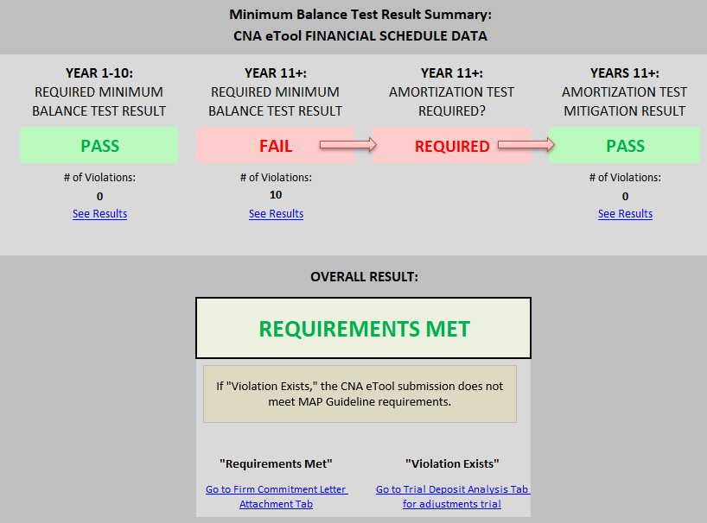
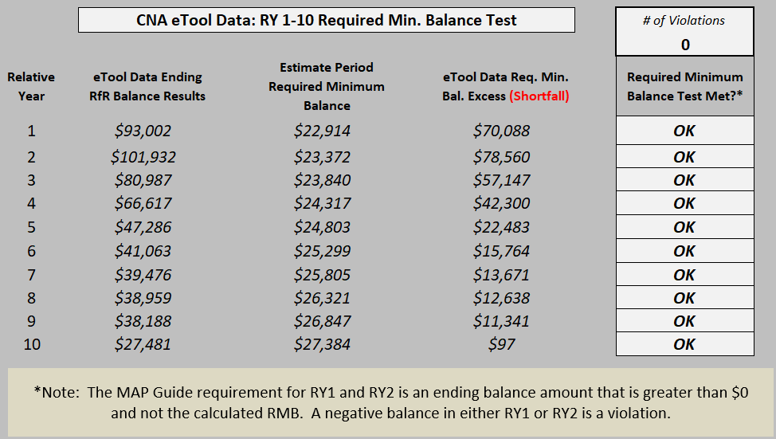
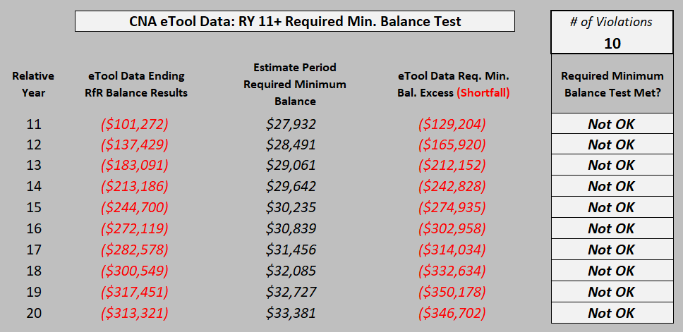
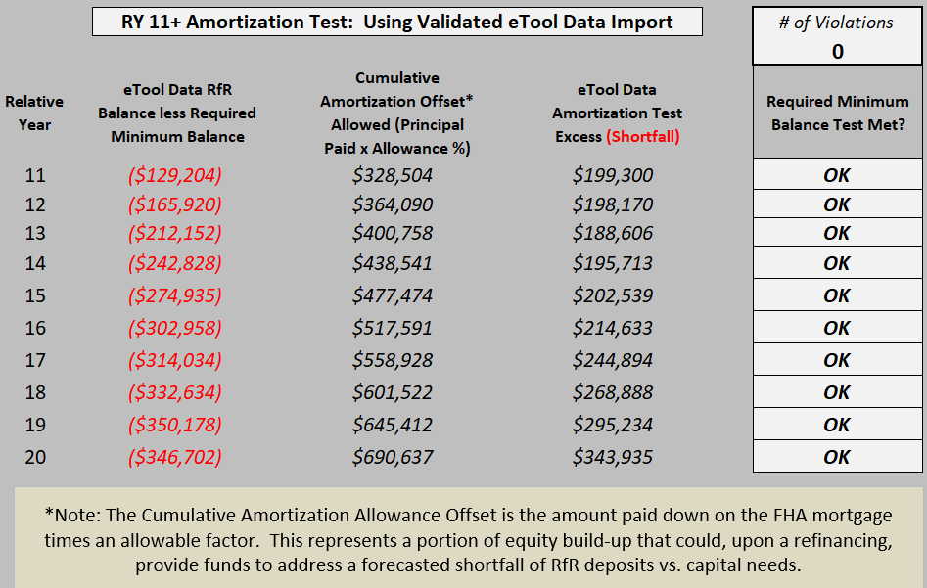
RFR Financial Factors Tool (FHA)
Must pass both tests
Minimum Balance Test (10 years)
Not required to pass
Minimum Balance Test (11-20 years)
Cumulative Amortization Test
Notes:
Connor

Slide 18
PCNA – Supplementary Reports
For properties >30 years old, an intrusive inspection is typically required
  Electrical inspection
  Sewer scoping
Seismic testing – for non-benchmark buildings in high seismic areas
  Benchmark buildings are typically those built after XXXX. Benchmark buildings still require a letter from an engineer confirming its status.
Modified AEC Report
  Suggested (required?) for properties considering >$15,000/unit in repairs and/or Level 2 repairs (require Architect/GC)
Notes:
Connor

Slide 19
FHA Accessibility Requirements
(2020 MAP Guide, Appendix, A.5.2 – pgs. 731-744/955)
Section 504 / Uniform Federal Accessibility Standards (UFAS)
Section 504 requires that recipients of federal financial assistance ensure that their programs and activities are readily accessible to and usable by individuals with disabilities.
As of July 11, 1988, newly-constructed housing and non-housing facilities must be designed and constructed to be readily accessible to and usable by persons with disabilities.
  For new construction multifamily housing projects, a minimum of 5 percent of the total dwelling units (or at least one unit, whichever is greater) must be made accessible for persons with mobility impairments.
  2 percent of the total units (or at least one unit, whichever is greater) must be made accessible for persons with hearing or vision impairments.
  In circumstances where greater need is demonstrated, HUD may prescribe higher percentages or numbers.
Americans with Disabilities Act (ADA)
  Title II of the ADA covers housing provided or made available by public entities (state and local governments and special purposes districts).
  Title III of the ADA prohibits private entities that own, lease, and operate places of public accommodation from discriminating on the basis of disability and requires places of public accommodation and commercial facilities to be designed, constructed, and altered in compliance with established accessibility standards.
  Public accommodations at housing developments include any public areas that are open to the general public, such as a rental office.
Fair Housing Act (FHA)
The FHA design and construction requirements include:
    Accessible public and common use areas
    Doors that are wide enough to allow passage by people using wheelchairs
    Accessible routes into and through the units
    Accessible light switches, electrical outlets, and thermostats,
    Reinforcements in bathroom walls for grab bars
    Usable kitchens and bathroom
HUD issued its Fair Housing Accessibility Guidelines to help builders and architects comply with these requirements in 1991.
Fair Housing Act requires residential buildings constructed after March 13, 1991, or permitted after June 15, 1990, be designed and constructed in compliance with the Act.
Note: State and Local Accessibility Laws. State and Local codes and standards may require greater accessibility than the Federal standards listed above. Where State or Local requirements exceed or vary from the Federal standards, the provisions applicable to particular elements of facilities that provide greater accessibility for persons with disabilities will prevail.
Notes:
Sam

Slide 20
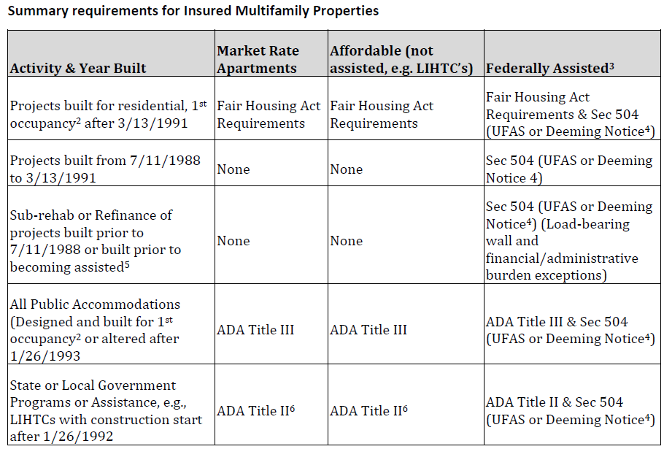
FHA Accessibility Requirements
1 Unlike the Fair Housing Act where Congress assigned regulatory and enforcement authority to HUD, Section 504 of the Rehabilitation Act of 1973 obligates various Federal Agencies to develop implementing regulations.
2 “1st occupancy” means a building that was never used for any purpose. Buildings first occupied as commercial or nonresidential never have to comply with Fair Housing.
3 “Federally assisted” projects include those financed or assisted by Project Based Vouchers, 202/811, HOME, HOPWA, Rent Supplements, 236, TCAP, BMIR, etc. LIHTC alone does not constitute Federal assistance unless aforementioned funds are utilized.
4 See HUD’s Alternative Accessibility Standard set forth in HUD's notice at 79 Fed. Reg. 29,671 (May 23, 2014) (“Deeming Notice”), permitting HUD recipients of Federal financial assistance to use an alternative standard for purposes of complying with Section 504 and HUD’s implementing regulation at 24 CFR part 8. The Deeming Notice provides HUD recipients the option of using the 2010 ADA Standards (with certain exceptions) as an alternative to UFAS for new construction or alterations commencing on or after May 23, 2014.
5 See Appendix 5, Section A.5.2.4.5 for a discussion on projects built before July 11, 1988, or before the date of Federal assistance.
6 State and local governments are required to describe specific measures to make programs accessible. Such measures vary especially in reference to existing properties. Appropriate state and local officials must be consulted, particularly
in reference to LIHTC transactions.
7 Adaptable Does Not Mean Deferrable. A common misinterpretation of the Fair Housing Act design and construction requirements holds that the term “adaptable” contemplates a delay or deferral of the time when “features of adaptable
design” required by the statute or regulations may be completed. This is inaccurate. The “features of adaptable design” described in the Fair Housing Act design and construction standards are required at original design and construction. Adaptable for purposes of Section 504 is defined at 24 CFR 8.3 and contemplates limited future physical changes to meet specific needs of particular persons with disabilities.
2020 MAP Guide, Appendix, A.5.2 – pg. 733
Notes:
Sam

Slide 21
PCNA – Hiring an Architect/GC
Required for 221(d)(4), 241(a), heavy 223(f), and/or level 2, level 3 repairs/replacements that are beyond the scope of the on-site maintenance staff
Examples
  Accessibility (redesigning units/spaces)
  Rehab
  Others
If a Project Architect is engaged:
Owner/Architect agreement, AIA B108.
Drawings/sketches for reconfigured spaces and/or altered site improvements
Full Plans/Specifications
If a Civil Engineer is engaged:
The owner/Architect agreement, AIA B108
Drawings/sketches for reconfigured spaces and/or altered site improvements
If a General Contractor is engaged:
Construction Contract, HUD 92442M
Contractor’s and/or Mortgagor’s Cost Breakdown, HUD 2328
Construction Progress Schedule, HUD 5372
Gantt Chart
Notes:
Sam
Discuss examples of Level 2 / 3 repairs

